Slide 1



Planning Ahead for Elders and families

Slide 2

ff
Notes:
Read acknowledgement traditional owners
funded by govt

Slide 3
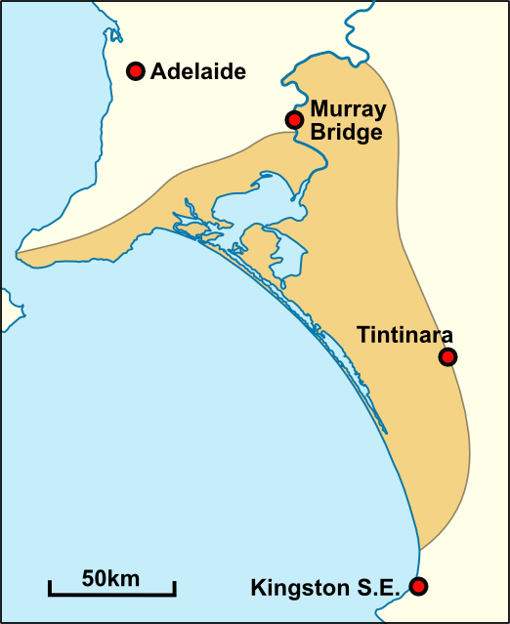
Overview
Why we made a DVD on Planning Ahead for Elders in the Lower Murray with Ngarrindjeri people
The process and the outcome
What we learnt
A small step in the
reconciliation process

Slide 4
Why a DVD
Feedback from our original Planning Ahead project
Gap in information for Aboriginal Elders
Local people telling their story
More accessible for rural people
A small step towards reconciliation
Notes:
As we all get older we are faced with services and decisions that can affect our quality of life, where we live, who looks after us if we get sick, what services can help, who provides them, who pays, what if we don’t like them
then there are lots of decisions to be made about treatment in hospital or by doctors.
If we have memory loss or a stroke or an accident, we may not be able to say what we want.
so we think its best to tell others now, ahead, put things into place when we can, take care of business so can focus more on living well right to the end of life.

Slide 5
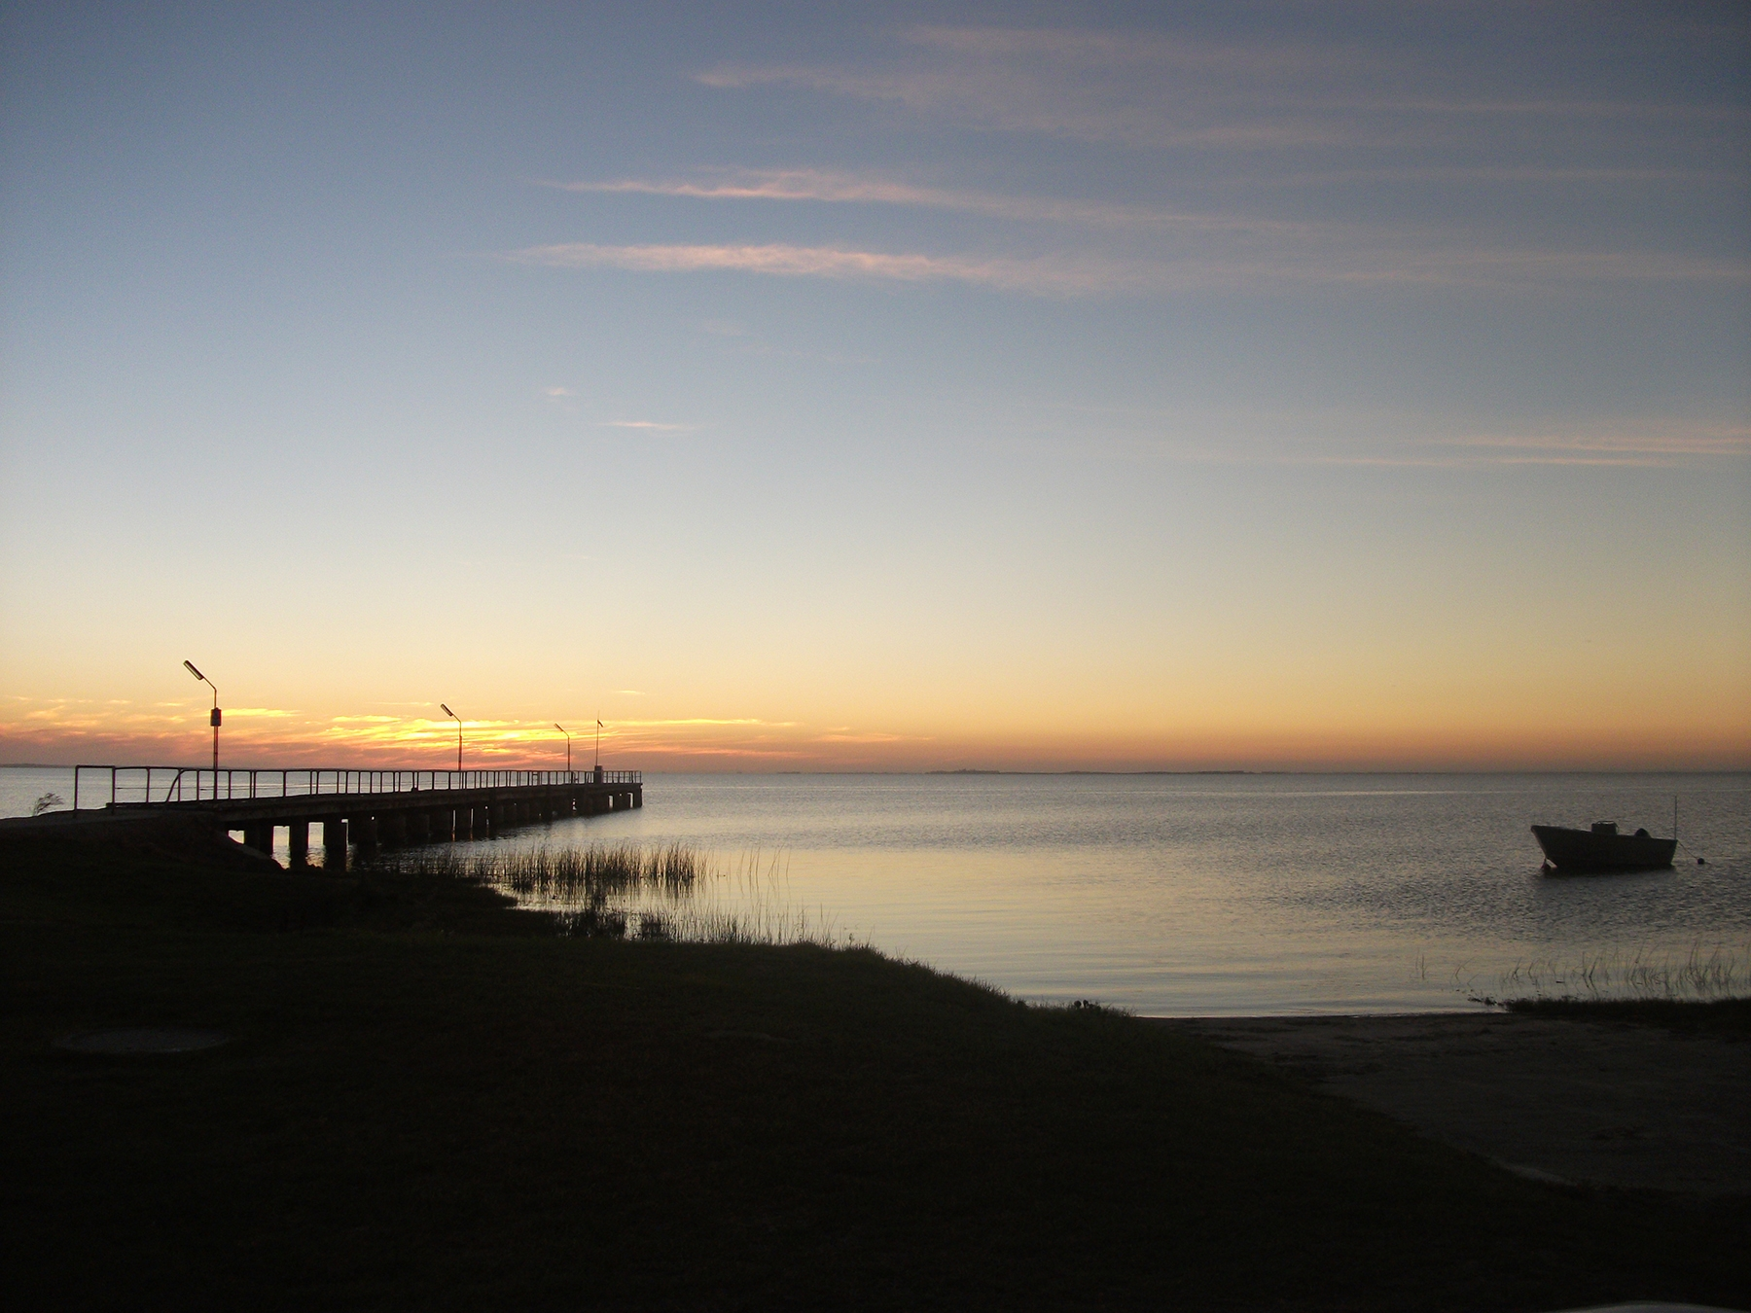

Slide 6
Process and outcome
Support from the Council of Aboriginal Elders in SA
Focussed on a local area where we have services
Involved the Elders Advisory Committee of Tumake Yande
Meeting, talking, raising sensitive issues
Maintaining the relationship
Asking local Elders and family members to star in the DVD
Resulted in a DVD that was local in focus but raised awareness more broadly
Raised the issue of who helps get families together to talk about these sensitive issues

Slide 7
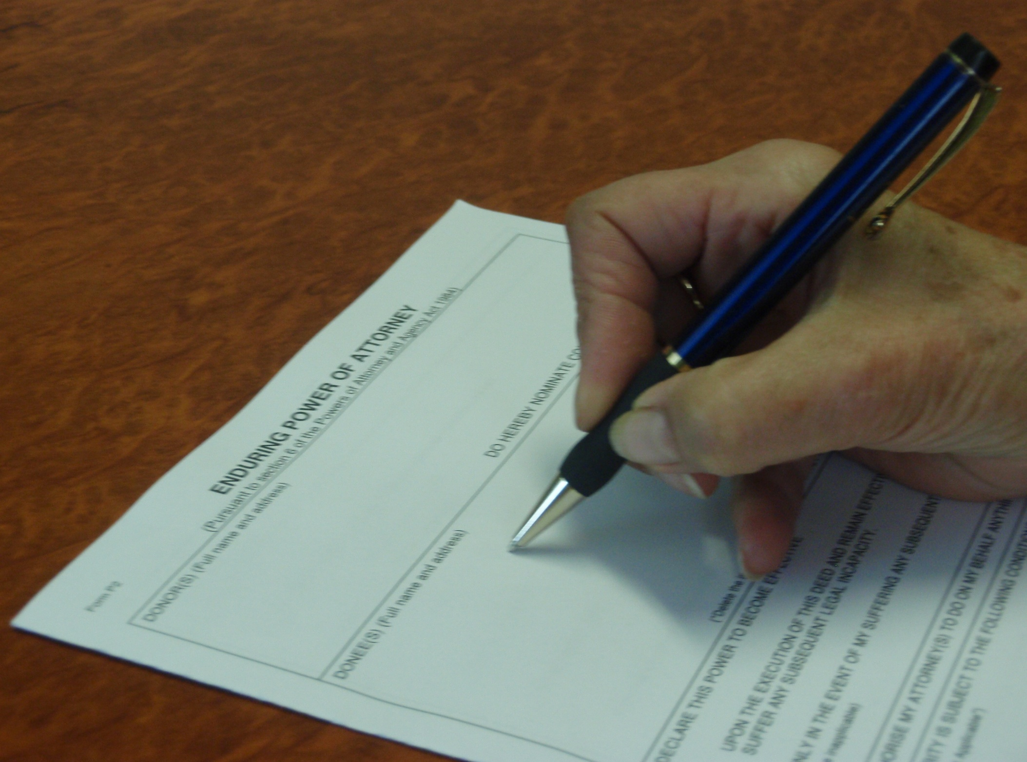
Advance Directives
Will
Enduring Power of Attorney
Enduring Power of Guardianship
Anticipatory Direction
Notes:
4 most common, most people are aware of wills for after we have died, the other 3 are for when we are alive but unable to say what we want for our care, treatment and how we want to live and die

Slide 8
Your Choices
tell people close to you about your wishes
appoint people to make decisions on your behalf –Advance Directives
write down your preferences
do nothing and leave decisions to your family or the government
Notes:
Not compulsory, be we think its best that we do something rather than leave it to family or the government

Slide 9
Take control
Talk with your family
Plan ahead so that your wishes can be respected
Let health and community services know your wishes

Slide 10


Slide 11
What we learnt
Trust takes time
Consult and ask opinions, listen to feedback
Involve local people
Advance Directives are complicated!
Information and awareness raising is the easy part
The next steps of getting families together to yarn is much harder
Who is able to assist this process?

Slide 12
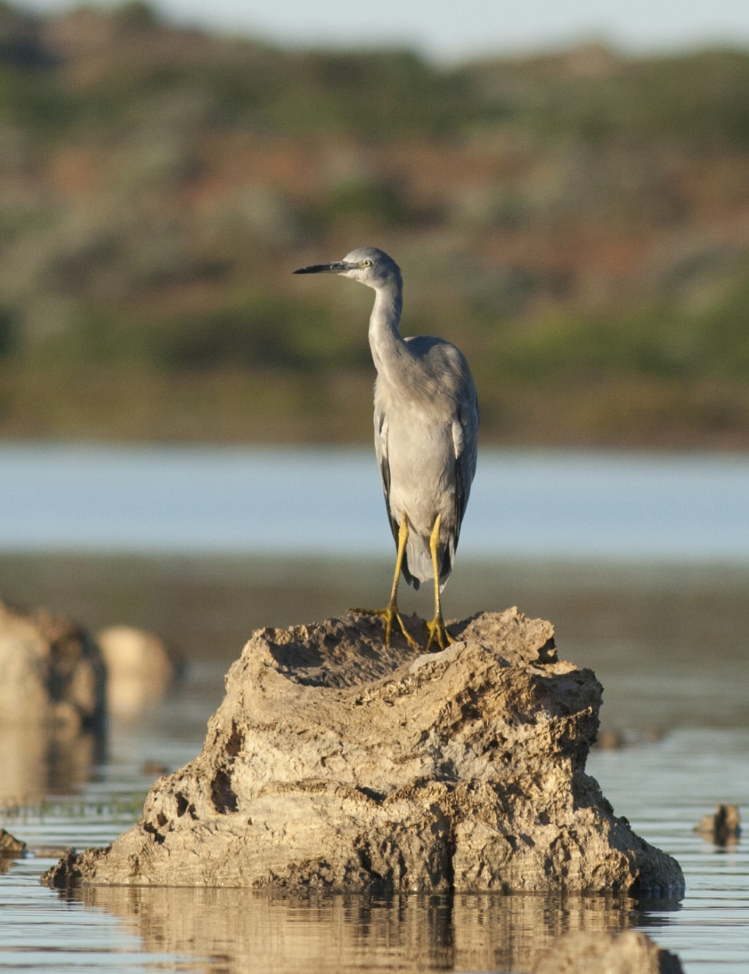
Resulted in a second version for all SA Aboriginal Elders and Families

Slide 14
Thank you
Lenore de la Perrelle
Manager Dementia Learning and Development Unit
Email ldelaperrelle@ach.org.au

