Slide 1


‘Cross
Cultural Communication’
- DR TOM
VERGHESE

Slide 2

intention
To better understand culture, cultural intelligence and bias so that you can be more effective when working across cultures.

Slide 3
SESSION ROAD MAP
CONTEXT SETTING
CULTURE
BIAS
CULTURAL INTELLIGENCE

Slide 4
KEY CHALLENGES
Relationship Management
Task Management
Self Management

Slide 5

THE ELEPHANT IN THE ROOM

Slide 6

Definitions of Culture
Culture ….. “the collective programming of the mind which distinguishes the members of one category of people from another.”
Hofstede, 1980984

Slide 7

Definitions of Culture
Culture ….. “the lenses through which you look at the world”
Verghese, 1999

Slide 8
Three Levels of Uniqueness in Human Mental Programming
Specific to individuals
Inherited and learned
PERSONALITY
Specific to group or category
Learned
CULTURE
Universal
HUMAN NATURE
Inherited
Hofstede, 1994

Slide 9
World view and Mental Models
World View : A particular philosophy of life or conception of the world.
Mental Model : Frameworks for thinking that simplify complex things so your brain can make sense of them.

Slide 10

11 million pieces of information
11 million pieces of information
40-50
Notes:
According to neuroscience, we are exposed to 11 million pieces of information at any one time, but can only deal with 40-50. That’s why we create categories and make assumptions. It helps us to make sense of things.
We notice someone’s skin colour in 100 milliseconds, someone’s gender in 150 milliseconds.
Unconscious bias can impact many decisions we make – whether it’s a hiring related decision or just day-to-day decisions involving people. Although we like to think that all hiring is based on merit, the reality is that our unconscious bias can influence our thinking and decisions.
Bias is normal. We all have biases – it’s an essential part of being human. The key is recognising them and acting on them, and it takes work every day to do this.

Slide 11
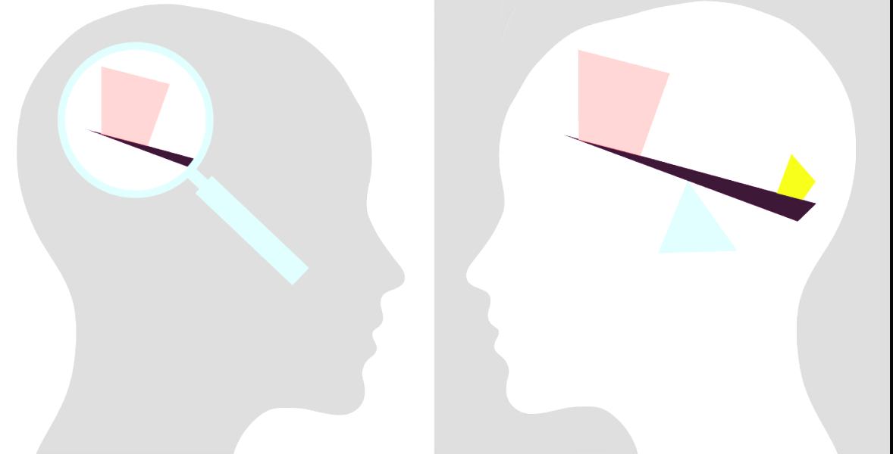
BIAS
Preference (+ve or –ve) for an individual or group based on attitudes, assumptions, stereotypes.
Can be explicit (aware/conscious) or implicit (unaware/unconscious)

Slide 12
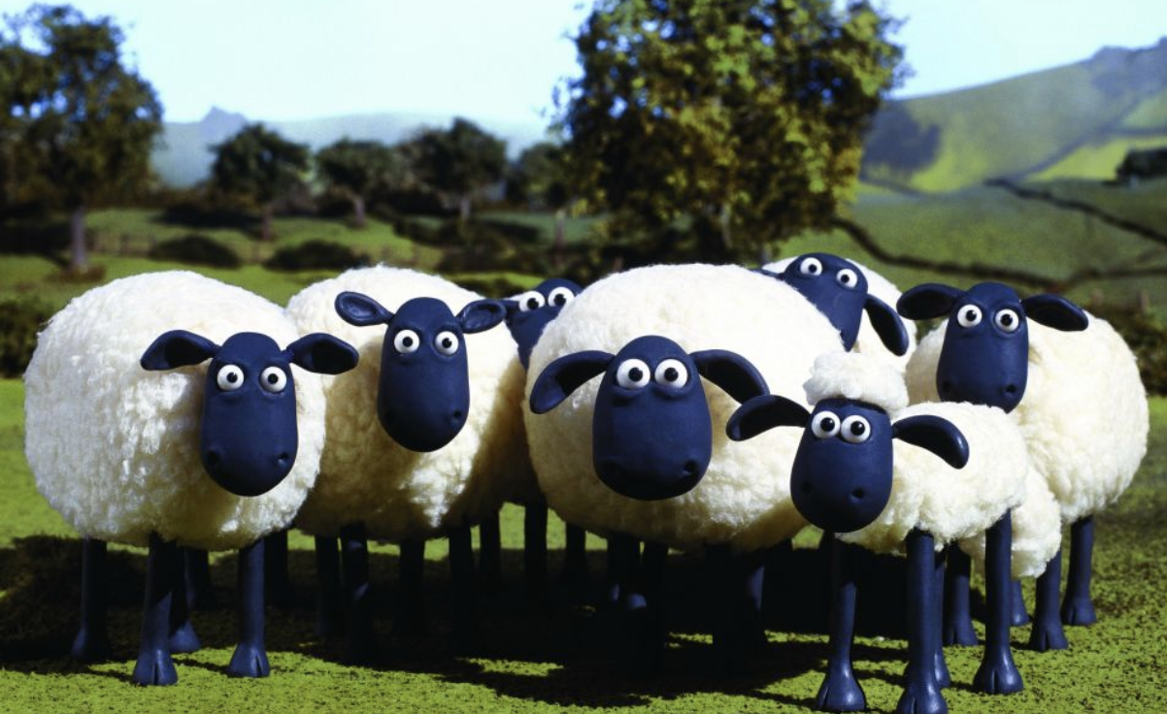

Slide 13
Product of Affinity Bias:
In- Groups and Out-Groups
In-group | Out-group
Members seen as individuals | Seen as homogenous
Differences accepted | Differences minimised
Positive information remembered | Less positive information recalled
Greater recall of contributions | More likely to forget contribution
Prepared to make sacrifices for in-group | Less prepared to offer support
Source: Binna Kandola, 2009
Notes:
Note outgroup fear of speaking up
When you’re in the dominant group, or in-group, we tend to treat those in your group more favourably. This slide shows how those in the in-group perceive others in the in-group and those in the out-group (i.e. it is done from the perspective of the in-group).
Inclusive leadership skills develop from an understanding of bias and in-groups and out-groups.
There is always a positive bias towards the dominant in-group in organisations.
Non-dominant groups learn to be vigilant and adaptable.
The Elephant and the Mouse

Slide 14
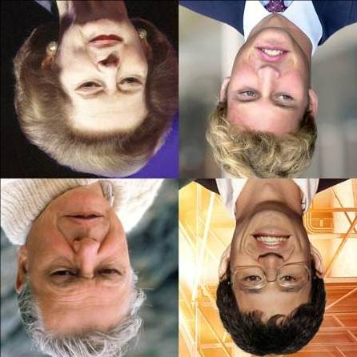
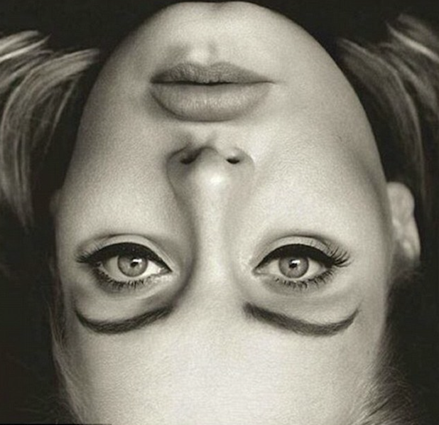
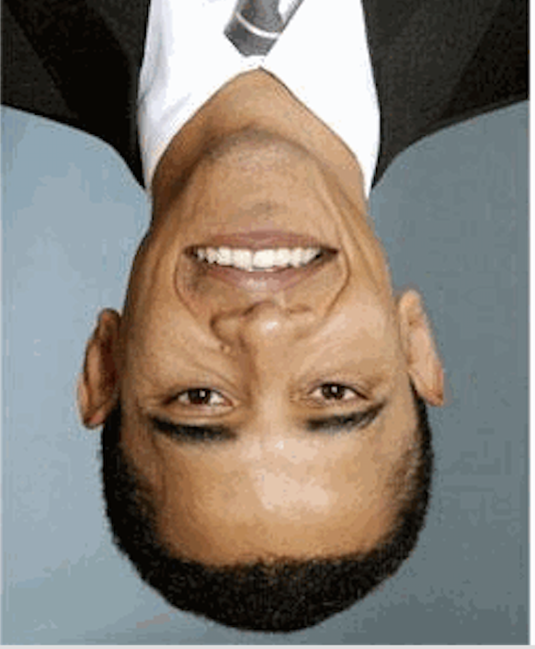
What do you see?

Slide 15
Notes:
Confirmation bias – key points:
We make decisions in a split of a second – then seek to confirm the information we need to persuade ourselves
We are prone to jump to conclusions based on previous expectations - we don’t process all the relevant information
How might this bias come into play at work and to what effect?

Slide 16


Slide 17
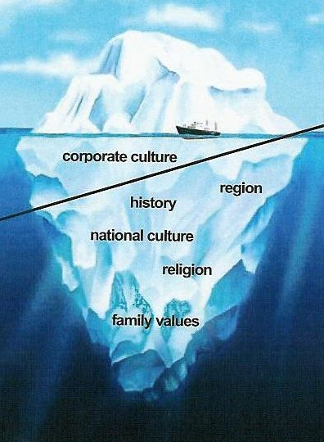
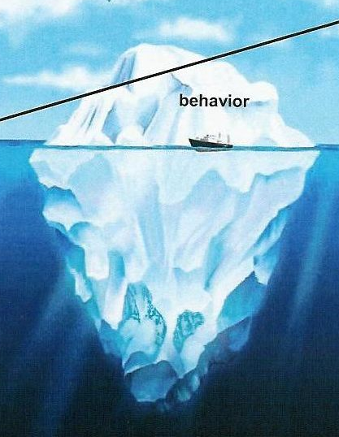


The Lens of Culture
Aperian 2007

Slide 18

‘Actions I take are totally decided by the perceptions I have’
Edward de Bono

Slide 19

CULTURAL INTELLIGENCE
‘An individual’s capacity to function and manage effectively in culturally diverse settings’
Source: Ang and Van Dyne 2008

Slide 20
4 CQ Capabilities
CQ DRIVE
Your interest, drive and confidence to adapt to multicultural situations
CQ KNOWLEDGE
Your understanding about how cultures are similar and different
CQ ACTION
Your ability to adapt when relating and working inter-culturally
CQ STRATEGY
Your awareness and ability to plan for multicultural interactions

Slide 21
CQ DRIVE
Notes:
Instead, the research reveals that the culturally intelligent—Individuals who effectively accomplish their objectives regardless of the cultural context—have strengths in four key capabilities. [Briefly reference the 4 CQ capabilities now and let them know you’ll be spending a significant part of the day explaining these more fully and interacting about them practically.]
The four capabilities of cultural intelligence are CQ Drive, CQ Knowledge, CQ Strategy, and CQ Action. They can also be thought of as four steps to developing CQ.
CQ Drive (motivation) is your interest, drive and confidence to adapt to a multicultural situation.

Slide 22
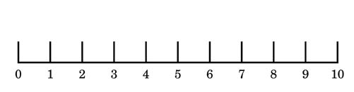
WHAT IS YOUR cultural DRIVE?
0 1 2 3 4 5 6 7 8 9 10
Low level of Interest
High level of interest

Slide 23
Developing CQ DRIVE Drive
Take some unconscious bias tests
Seek feedback from peers
Reflect on what guides and influences your behaviours and attitudes toward culturally diverse groups
Welcome opportunities to mentor others as a ‘cultural broker’
Seek an interest that you have and leverage on it. Read an online overseas newspaper or connect with culturally diverse peers via LinkedIn
Be prepared to make mistakes

Slide 24
CQ DRIVE
CQ KNOWLEDGE
Notes:
CQ Knowledge (cognition) is your understanding about how cultures are similar and different.

Slide 25

Global Cultural Clusters
Anglo ( Australia, Canada, England, Ireland, New Zealand, South Africa (White sample), and the United States of America).
Eastern Europe ,Albania, Georgia, Greece, Hungary, Kazakhstan, Poland, Russia, Slovenia).
Nordic Europe (Denmark, Finland, Sweden).
Germanic Europe (Austria, Germany, the Netherlands, German-speaking Switzerland).
Latin Europe (France, Israel, Italy, Portugal, Spain, French-speaking Switzerland).

Slide 26
Global Cultural Clusters
Sub Saharan Africa (Namibia, Nigeria, South Africa (black sample), Zambia, Zimbabwe).
Confucian Asia (China, Hong Kong, Japan, Singapore, South Korea, Taiwan).
Southern Asia (India, Indonesia, Malaysia, the Philippines, Thailand).
Middle East (Egypt, Iran, Kuwait, Morocco, Qatar, Turkey).
Latin America (Argentina, Bolivia, Brazil, Colombia, Costa Rica, Ecuador, El Salvador, Guatemala, Mexico, Venezuela).
(Javidan et al. 2006).

Slide 27

Stereotype VS
GeneralIzation
Stereotype: Negative or positive judgments made on the basis of any group membership.
Generalization: broad statements based on research, facts, experiences or examples.

Slide 28


Relationship — Task
Focus on people
Focus on task

Slide 29


Hierarchical - Equality
Vertical view of society
Horizontal view of society

Slide 30
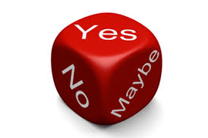
High Context — Low
Context Communication
‘Yes’ means ‘yes’, ‘no’ or ‘maybe’?
‘Yes’ means ‘yes’
Yes.

Slide 31
Various cultures on the context
scale
High context
Far East (Japan, China etc)
Indian subcontinent
Arab countries
Latin America
Eastern Europe
Latin Europe
United Kingdom
Australia, Canada
United States
Scandinavia
Germany
Low context
Switzerland
Source: Managing Cultural Diversity in Technical Professions, Lionel Laroche, 2003

Slide 32
Your Cultural Mirror
Relationship Task
Hierarchical Equality
High Context Low Context Communication

Slide 33
Developing CQ Knowledge
Learn a new language
Visit art galleries or museums that display stories and artworks from other countries. Watch films and read books that tell stories about different cultures, their histories and locations
Visit culturally significant places to learn more about them i.e. a mosque, synagogue or sporting venue
Listen to and watch people of different cultural groups, observe how they interact with each other
Be curious

Slide 34
CQ DRIVE
CQ KNOWLEDGE
CQ STRATEGY
Notes:
CQ Strategy (meta-cognition) is your awareness and ability to plan for multicultural interactions.

Slide 35
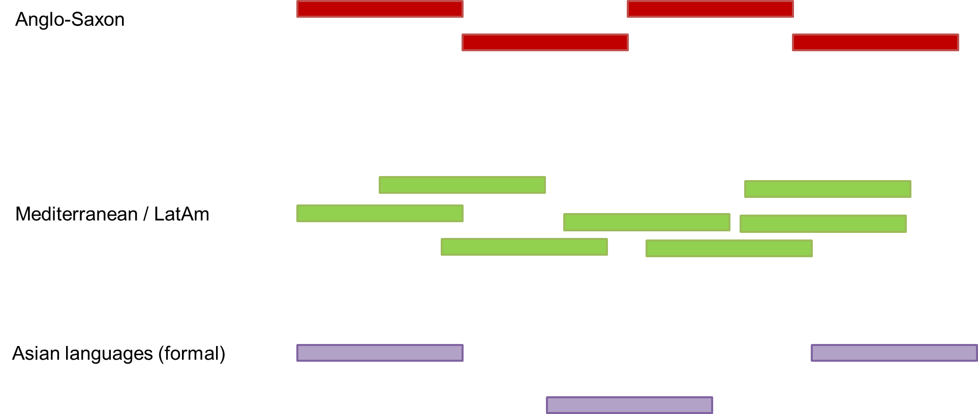
Turn-taking, interruptions and silence
Anglo Saxon
Mediterranean/ Latin
America
Asian Languages

Slide 36
Developing CQ Strategy
Seek and offer feedback from/to others intermittently and informally
Take the time to consider where and why you might be feeling frustrated
Share stories of your cultural successes and failures, i.e. how you thought they would be versus the realities
Observe your own behaviours and emotions when you are in different cultural settings i.e. are you feeling irritated, bored, excited, frustrated etc
Learn basic small talk, norms and social behaviours that are culturally appropriate
Practice mindfulness

Slide 37
CQ DRIVE
CQ KNOWLEDGE
CQ ACTION
CQ STRATEGY
Notes:
CQ Action (behavior) is your ability to adapt when relating and working interculturally.

Slide 38
Communication Tips
Pay attention to the person and the message
Emphasise and create rapport
Share meaning i.e. clarify understanding by paraphrasing
Pause and be mindful

Slide 39
Developing CQ Action
Take time to observe how your behaviour is being received by others
Seek feedback from people who are trusted colleagues
Have courage to provide feedback to others based on your observations – albeit in an appropriate manner
Reflect on the relationships between your influences, experiences and behaviours
Make an extra effort to stop and listen before responding
Develop humility and resilience
Seek out a cultural mentor

Slide 40
4 CQ Capabilities
CQ DRIVE
Your interest, drive and confidence to adapt to multicultural situations
CQ KNOWLEDGE
Your understanding about how cultures are similar and different
CQ ACTION
Your ability to adapt when relating and working inter-culturally
CQ STRATEGY
Your awareness and ability to plan for multicultural interactions

