Slide 1

Conscious Inclusion:
Moving on from Unconscious Bias
10 May 2022

Slide 2


Acknowledgement of Country
The Centre for Cultural Diversity in Ageing acknowledges the Traditional Owners
and Custodians of country throughout Australia. We pay our respect to Aboriginal
and Torres Strait Islander peoples and their Elders, past, present and emerging.
We acknowledge their continuing connection to land, sea and community.
We would like to extend that acknowledgement and respect to any Aboriginal
and Torres Strait Islander peoples listening to this presentation.
We hope our work contributes to fostering respect and recognition between
cultures in Australia.

Slide 3



About us
OUR VISION
All aged care consumers in Australia experience inclusive and accessible care
OUR PURPOSE
To build the capacity and capabilities of Australian aged care providers to deliver services that are welcoming, inclusive and accessible
OUR SERVICE AREAS
Inclusive practice training and workshops
Capacity building to promote cultural inclusion and equity
Diversity advice and consulting
The Centre for Cultural Diversity in Ageing is supported by Benetas & funded by the Australian Department of Health through the Partners in Culturally Appropriate Care (PICAC) program.

Slide 4
What we’ll cover today
Introduction of presenters
Biljana Grbevska, Project Admin Officer, Centre for Cultural Diversity in Ageing
Presentation on Conscious Inclusion: Moving on from Unconscious Bias
Bedi Othow, Co-founder, DivTal
Lorna Deng, Co-founder, DivTal
Q&A session
Lisa Tribuzio, Manager, Centre for Cultural Diversity in Ageing
Where to go for support
Nikolaus Rittinghausen, Senior Advisor and Project Officer, Centre for Cultural Diversity in Ageing

Slide 5
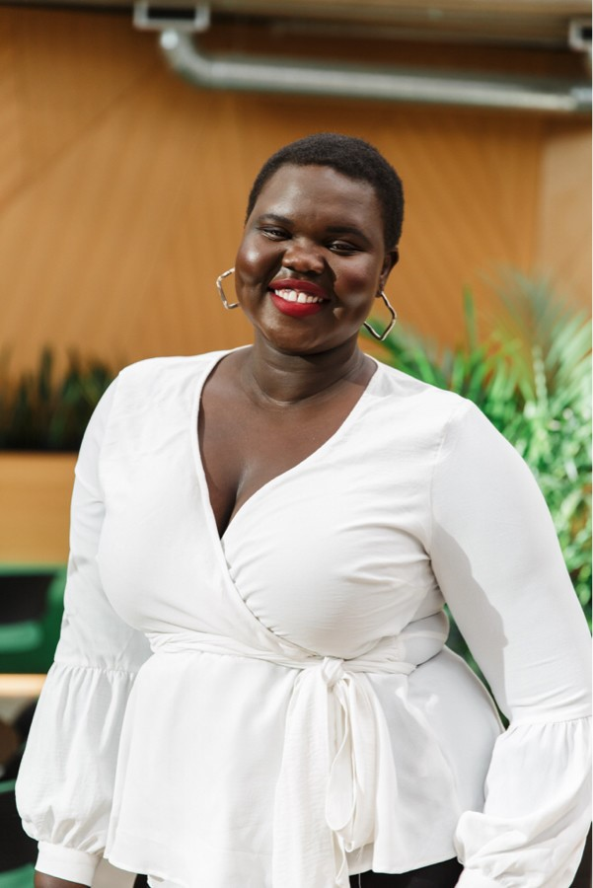
Bedi Othow
Bedi is a passionate Human Resource professional with over 10 years' experience within the legal and public sectors. She is involved in numerous diversity & inclusion committees and is a strong advocate for inclusion within the workplace. She's also the proud co-founder of DivTal, an online job platform that connects inclusive employers to Black, Indigenous and People of Colour candidates.
In 2021, Bedi was appointed the Principal Advisor, People and Culture at the Victorian Equal Opportunity and Human Rights Commission.

Slide 6
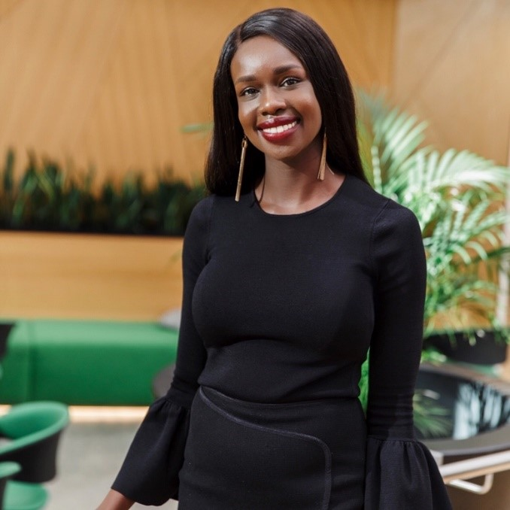
Lorna Deng
Lorna is the co-founder of DivTal. DivTal is a social enterprise that connects Black, Indigenous and People of Colour candidates to employers. Recently named by Smart Company as one of ‘Australia’s 13 most inspiring female entrepreneurs’ her purpose is to help create a more inclusive future of work.
Lorna is a speaker and a member of various diversity & inclusion committees.

Slide 7
Q&A
Notes:
Opening up for questions and comments

Slide 8
Where to go for support
Notes:
Opening up for questions and comments

Slide 9
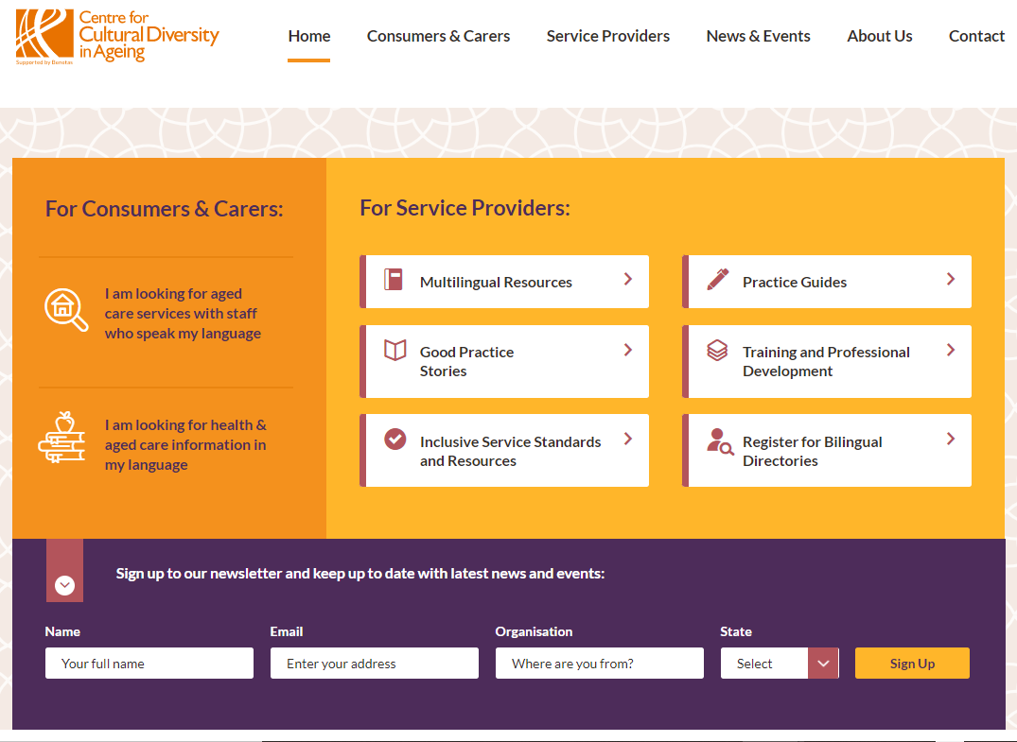
The Centre for Cultural Diversity in Ageing website
culturaldiversity.com.au

Slide 10
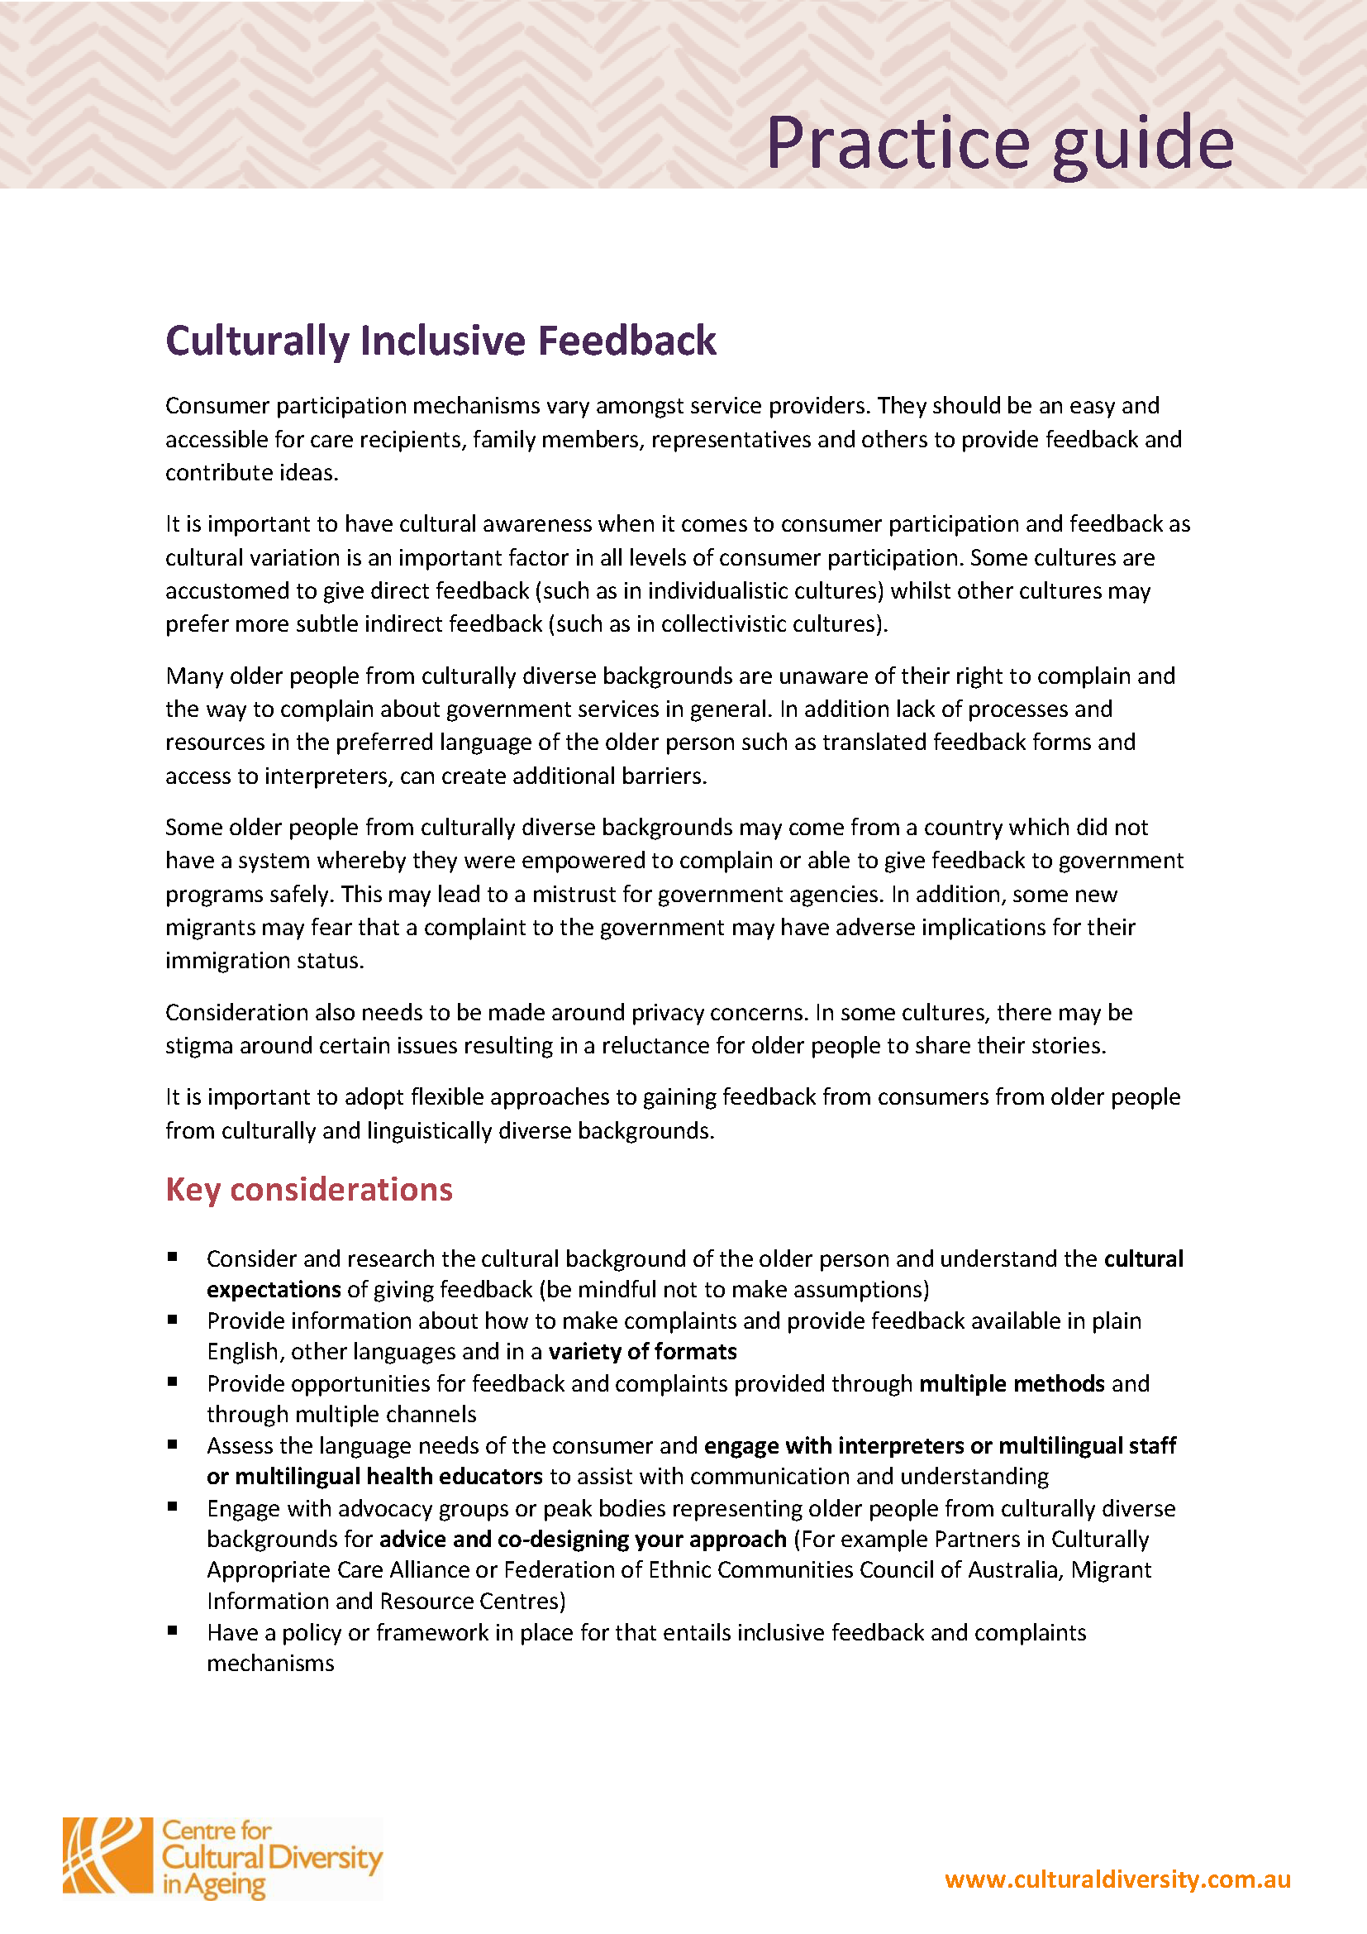
Practice Guides
Culturally Inclusive Feedback
Communication
Data and Demographics
Food and Nutrition
Living Environment
10 Steps to Developing a Diversity, Equity and Inclusion Plan in Aged Care
Spiritual Support
Working with Bilingual Staff
Interpreters Policies
Cultural-specific Information
Digital Inclusion
Accessing Interpreter Services
Effective Co-design with Consumers from Culturally and Linguistically Diverse Backgrounds
Download from
culturaldiversity.com.au

Slide 11

Poster
Download from culturaldiversity.com.au/about/promotional-posters

Slide 12
Diversity Webinar Series 2022
Managing Equal & Mutually Beneficial Partnerships with Multicultural Communities – 22 June
To register go to bit.ly/diversity-webinar-series-22

Slide 13






Thank you!
Thank you for participating today.
For more information, good practice stories and resources visit
culturaldiversity.com.au
Centre for Cultural Diversity in Ageing
Centre for Cultural Diversity in Ageing
CCDAAUS
Thank you Sarah Burrell-Davis
Digital Content Producer/Consultant
at Red Hat Films for all your support!

