Slide 1

The Inclusive Service Standards for Beginners
Diversity Coaching Workshop
14 September 2022

Slide 2


Acknowledgement of Country
The Centre for Cultural Diversity in Ageing acknowledges the Traditional Owners
and Custodians of country throughout Australia. We pay our respect to Aboriginal
and Torres Strait Islander peoples and their Elders, past, present and emerging.
We acknowledge their continuing connection to land, sea and community.
We would like to extend that acknowledgement and respect to any Aboriginal
and Torres Strait Islander peoples listening to this presentation.
We hope our work contributes to fostering respect and recognition between
cultures in Australia.

Slide 3



About us
OUR VISION
All aged care consumers in Australia experience inclusive and accessible care
OUR PURPOSE
To build the capacity and capabilities of Australian aged care providers to deliver services that are welcoming, inclusive and accessible
OUR SERVICE AREAS
Inclusive practice training and workshops
Capacity building to promote cultural inclusion and equity
Diversity advice and consulting
The Centre for Cultural Diversity in Ageing is supported by Benetas & funded by the Australian Department of Health and Aged Care through the Partners in Culturally Appropriate Care (PICAC) program.

Slide 4
Poll 1
What services do you provide?
Notes:
Anonymous
Your voice is important
Feed up to Dep
What organisation are you from?
What brings you here today?
What are some of the languages that your clients speak and for what languages do you see the highest need?
Read some of the answers
People on a mobile phone can answer questions in chat.
Department is interested of service for people in regional/ rural communities. This is to measure equity.

Slide 5
Poll 2
What type of service are you?
Notes:
Anonymous
Your voice is important
Feed up to Dep
What organisation are you from?
What brings you here today?
What are some of the languages that your clients speak and for what languages do you see the highest need?
Read some of the answers
People on a mobile phone can answer questions in chat.
Department is interested of service for people in regional/ rural communities. This is to measure equity.

Slide 6
Poll 3
Does your organisation provide aged care services to rural, regional or remote communities?
Notes:
Anonymous
Your voice is important
Feed up to Dep
What organisation are you from?
What brings you here today?
What are some of the languages that your clients speak and for what languages do you see the highest need?
Read some of the answers
People on a mobile phone can answer questions in chat.
Department is interested of service for people in regional/ rural communities. This is to measure equity.

Slide 7
Quick Stats
      There are over 420 languages spoken in Australia including 183 Indigenous languages. (Source: SBS)
      The top 5 languages used at home, other than English, are Mandarin, Arabic, Vietnamese, Cantonese and Punjabi. (Source: Census 2021)
      Around 37% of people over 65 years were born overseas. (Source: Census 2021)
      The 2021 Census data collected information from more than 120 religions and faiths.
      In Department of Health and Ageing data from 2020 around 28% of people using home care and
      20% of people using permanent residential and respite care were from a CALD background (in this case Department of Health define CALD as people who were born overseas in countries other than UK, Ireland, NZ, Canada, South Africa and USA).
      There is also a culturally diverse aged care workforce. 21% of the total direct care workforce identify as being from a CALD background. (Source: Department of Health, 2020, Aged Care Workforce Census)
      Personal Care Workers account for 91% of all CALD direct care workers.
      (Source: Department of Health, 2020, Aged Care Workforce Census)
Notes:
Anonymous
Your voice is important
Feed up to Dep
What organisation are you from?
What brings you here today?
What are some of the languages that your clients speak and for what languages do you see the highest need?
Read some of the answers
People on a mobile phone can answer questions in chat.
Department is interested of service for people in regional/ rural communities. This is to measure equity.

Slide 8

Lisa Tribuzio
Lisa Tribuzio has 22 years experience in a range of sectors including:
Assistant Director for Inclusion Strategies at the NDIA, Diversity Advisor for the Hume Whittlesea Primary Care Partnership working with aged care and disability providers, Projects Manager for the Victorian Arabic Social Services and researcher at the Institute for Citizenship and Globalisation at Deakin University.
She has also undertaken cross-cultural research in Egypt for the Centre for Intercultural Dialogue in Cairo.
Lisa is the founder of Lotus Consulting which aims to assist organisations in developing deep understandings of diverse perspectives and practices.

Slide 9
The Inclusive Service Standards for Beginners
Notes:
Opening up for questions and comments

Slide 10
Inclusive Service Standards
The Inclusive Service Standards were developed by the Centre for Cultural Diversity in Ageing in 2018 to assist aged care organisations become better equipped at addressing the diverse needs of their consumers and journeying toward inclusive practice.
They provide a structure through which organisations can embed inclusive practices across all policies, strategies and service provision.

Slide 11
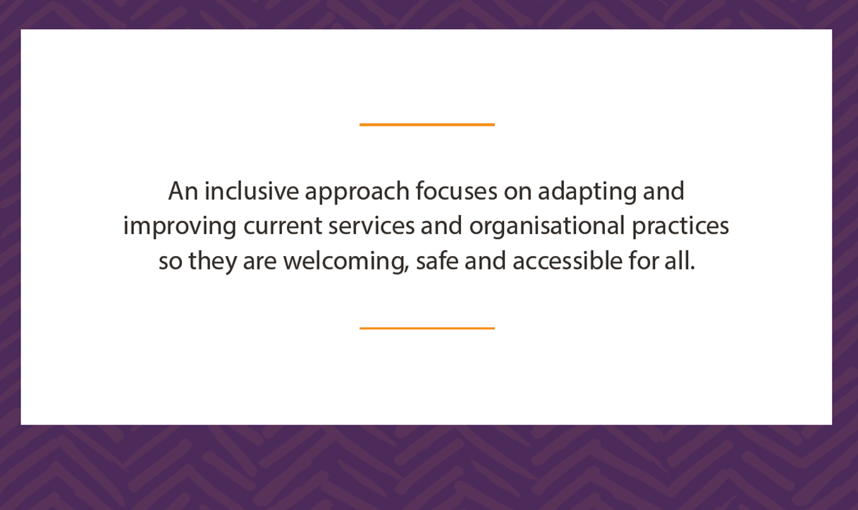

Slide 12
Building blocks of an inclusive approach
Equity
Diversity
Inclusion

Slide 13
Equity is about fairness.
It is about recognising that disadvantage exists and finding solutions to the barriers, behaviours and attitudes that create unequal situations and outcomes.
In order to be fair it is necessary to treat people differently.
Equity doesn’t mean disadvantaging anyone. It is about making the playing field level.
Equity

Slide 14
Diversity encompasses any characteristic used to differentiate one person from another.
These characteristics permeate the way we individually experience the world, the way we self-identify and the way we are identified by others.
These characteristics and attributes shape who we are and what is important to us.
We can identify with multiple characteristics at any given time or given context.
Diversity

Slide 15
Poll 4
What does Diversity mean to you?
Notes:
Anonymous
Your voice is important
Feed up to Dep
What organisation are you from?
What brings you here today?
What are some of the languages that your clients speak and for what languages do you see the highest need?
Read some of the answers
People on a mobile phone can answer questions in chat.
Department is interested of service for people in regional/ rural communities. This is to measure equity.

Slide 16
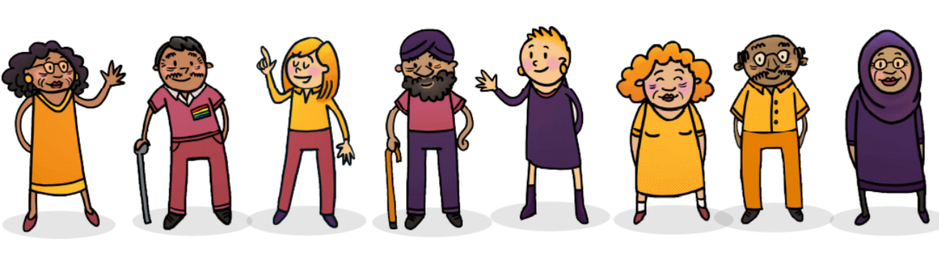
Diversity characteristics
Beliefs around ageing
Living with a Disability
Beliefs around end of life
Life Experiences
Ideologies and political views
Temperament/Personality
Sexual identity
Ethnic Identity
Age
Family roles
Mental Health
Education
Caring Roles
Gender identity
Language
Health
Income
Physical appearance
Family culture
Migration journey
Geography
Suburban identity
Professional Identity
Spiritual identity
Housing
Living in rural/remote living
Indigenous Heritage
Employment

Slide 17
People have overlapping identities and experiences
Ideologies and political views
Education
Temperament/Personality
Living with a disability
Mental Health
Spiritual identity
Ethnic identity
Physical appearance
Family culture
Age
Language
Caring Roles
Gender identity
Geography
Employment
Health
Migration journey
Living with a disability
Professional Identity
Family roles
Income
Sexual Identity
Housing
Suburban identity
Life Experiences
Indigenous Heritage
Understanding how diversity characteristics intersect can guide us towards holistic and person centred care

Slide 18
Inclusion is positive action taken to help consumers participate and be represented in all areas.
Inclusion is where environments are welcoming, people feel comfortable to be themselves and they are empowered.
Creating inclusive services and environments means addressing power and privilege imbalances.
Inclusion

Slide 19

Diversity and inclusion in the aged care sector
Aged Care Diversity Framework (2017)
The diversity framework works to embed diversity in the design and delivery of aged care services.

Slide 20
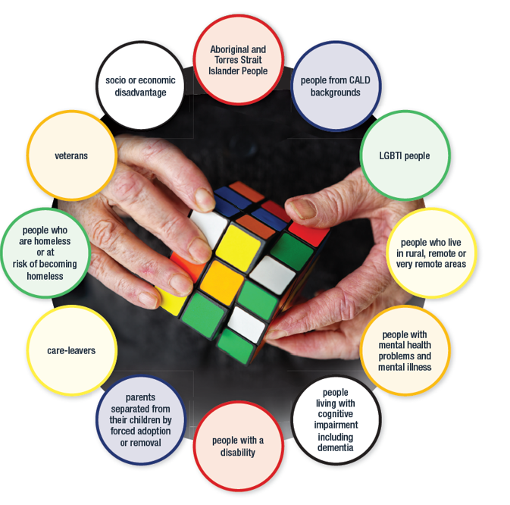
Special needs groups in the Aged Care Diversity Framework
Aged care Diversity Framework 2017

Slide 21

Inclusive Service Standards
Standard 1:
Commitment to inclusive services
Standard 2:
Developing systems that support inclusive services
Standard 3:
Capacity building for inclusive services

Slide 22
Standard 1 – Commitment to Inclusive Services
The organisation clearly articulates its commitment to building an environment which responds to consumer diversity and embeds inclusive service provision across all of its systems.

Slide 23
Standard 2 – Developing systems that support inclusive services
The organisation designs and implements inclusive services based on evidence derived from organisational reviews and consultation with stakeholders.

Slide 24
Standard 3 – Capacity Building for inclusive services
The organisation’s management and staff are equipped with knowledge, skills and resources required to plan and deliver inclusive services.

Slide 25
Inclusive Service Standards Online Portal
The portal was developed with the aim to support providers to navigate and report against the Inclusive service standards.
Developed in 2020 in partnership with BNG, an online platform provider designed to support health service providers with operations, governance and compliance.
Portal is free and contains:
Self-assessment tools
Reading room
Tips and Templates to support inclusive service
Invitations for good practice across the sector
culturaldiversity.com.au/service-providers/inclusive-service-standards-portal

Slide 26
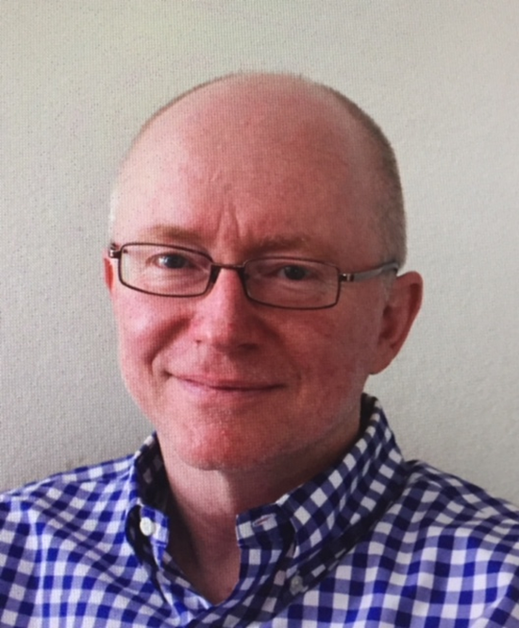
James Houstone
James Houstone is a Director of Breaking New Ground (BNG), which is a leading provider of online solutions for Australian community services and health service providers, in the areas of quality and service standards, quality management systems and organisational capacity building.
BNG partners with the Centre for Cultural Diversity in Ageing to provide the Inclusive Service Standards Portal, which supports aged care providers to self-assess against the Inclusive Service Standards, and to identify any gaps or areas for improvement.

Slide 27
Poll 5
Action Plan 1
Notes:
Anonymous
Your voice is important
Feed up to Dep
What organisation are you from?
What brings you here today?
What are some of the languages that your clients speak and for what languages do you see the highest need?
Read some of the answers
People on a mobile phone can answer questions in chat.
Department is interested of service for people in regional/ rural communities. This is to measure equity.

Slide 28
Poll 6
Action Plan 2
Notes:
Anonymous
Your voice is important
Feed up to Dep
What organisation are you from?
What brings you here today?
What are some of the languages that your clients speak and for what languages do you see the highest need?
Read some of the answers
People on a mobile phone can answer questions in chat.
Department is interested of service for people in regional/ rural communities. This is to measure equity.

Slide 29
Poll 7
Action plan 3
Notes:
Anonymous
Your voice is important
Feed up to Dep
What organisation are you from?
What brings you here today?
What are some of the languages that your clients speak and for what languages do you see the highest need?
Read some of the answers
People on a mobile phone can answer questions in chat.
Department is interested of service for people in regional/ rural communities. This is to measure equity.

Slide 30
Poll 8
What does your organisation need to support its Inclusive Service Standards journey?
Notes:
Anonymous
Your voice is important
Feed up to Dep
What organisation are you from?
What brings you here today?
What are some of the languages that your clients speak and for what languages do you see the highest need?
Read some of the answers
People on a mobile phone can answer questions in chat.
Department is interested of service for people in regional/ rural communities. This is to measure equity.

Slide 31
Where to go for support
Notes:
Opening up for questions and comments

Slide 32
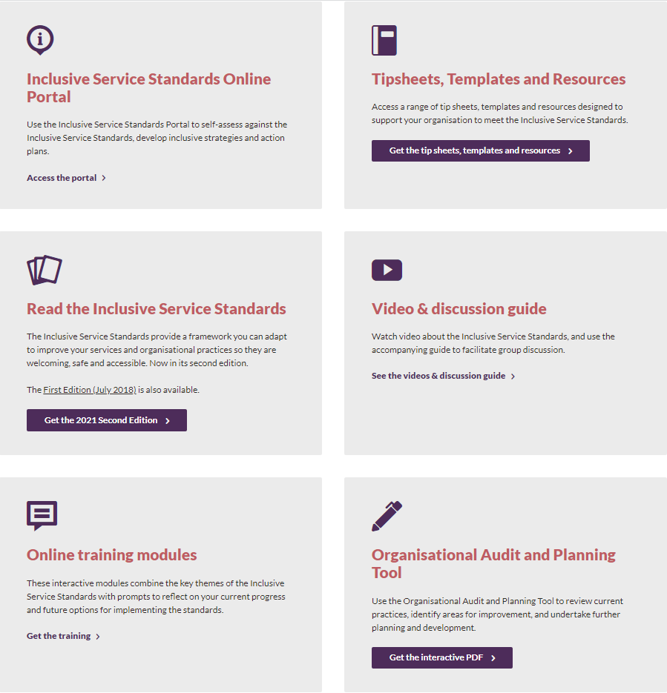
Inclusive Service Standards and Resources
The Inclusive Service Standards were developed by the Centre for Cultural Diversity in Ageing to assist aged care providers in the development and the delivery of inclusive services to all consumers.
They provide a framework for services to adapt and improve their services and organisational practices so they are welcoming, safe and accessible.
culturaldiversity.com.au/inclusive-service-standards

Slide 33

Diversity Mentoring Program
The Diversity Mentoring program is a co-design program involving a collaboration between an aged care service and the Centre for Cultural Diversity in Ageing. The program links leaders from the aged care service to diversity mentors from the Centre for Cultural Diversity in Ageing in a six month mentoring relationship.
The aim of the program is to support the aged care leaders within the service to develop the initial stages of a diversity and inclusion approach across the whole organisation. It will involve monthly diversity mentoring consultations and two online training sessions on culturally appropriate care delivered to leaders and direct care staff.
culturaldiversity.com.au/training-development/
diversity-mentoring-program

Slide 34
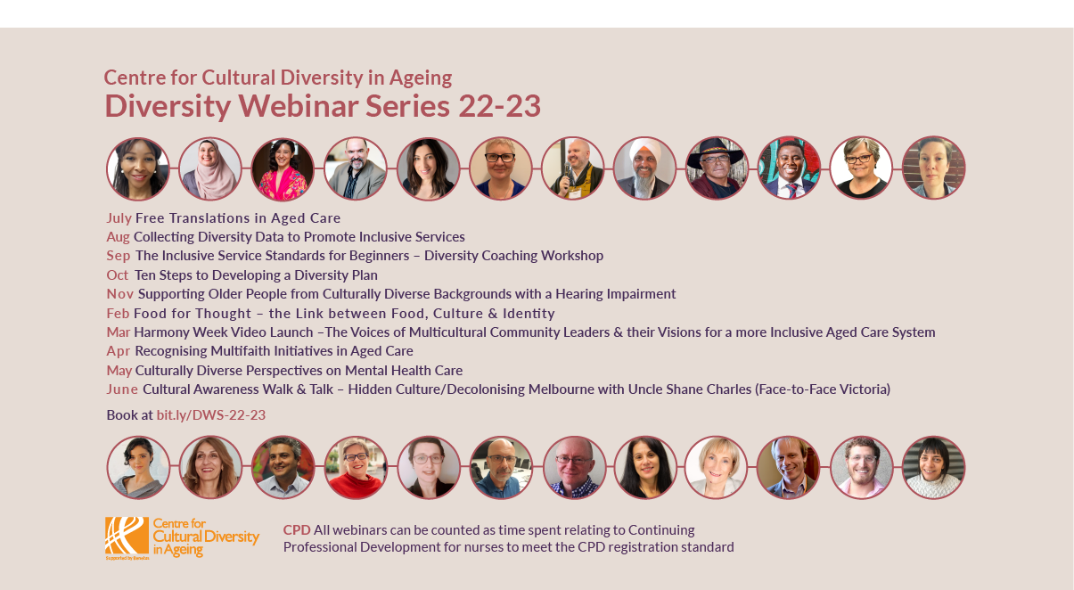
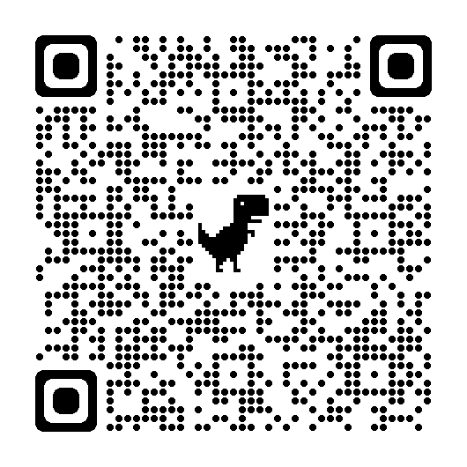
Notes:
Opening up for questions and comments

Slide 35
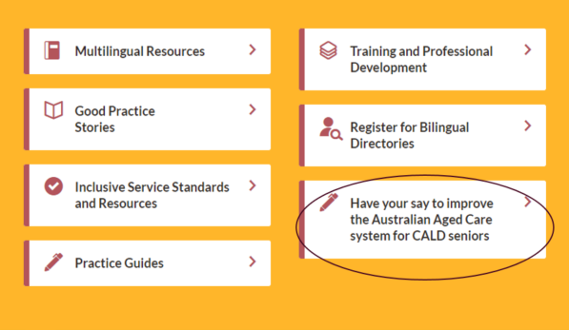
The Centre for Cultural Diversity in Ageing website
Have your say survey available on our homepage
culturaldiversity.com.au

Slide 36

Everybody has a story – free learning module
Everybody has a story: Delivering culturally inclusive care module by the Aged Care Quality and Safety Commission was created in partnership with the Centre for Cultural Diversity in Ageing.
To learn more visit:
culturaldiversity.com.au/training-development/everyone-has-a-story

Slide 37
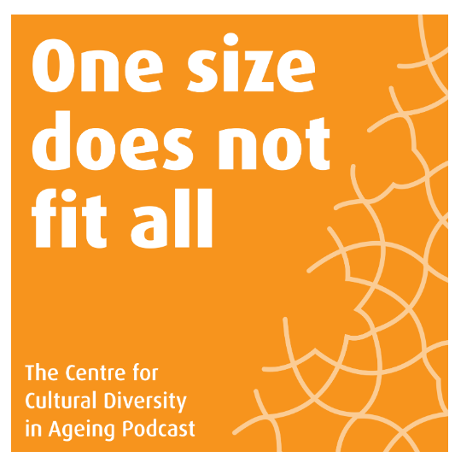
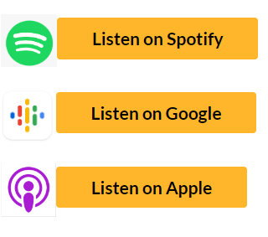
Podcast
To listen visit:
culturaldiversity.com.au/news-and-events/podcasts

Slide 38
Connecting older Australians to aged care services – better connecting with diverse audiences
One of the 2021 Aged Care Royal Commission’s key recommendations was to ensure that diversity is core business in aged care. Connecting older Australians to aged care services – better connecting with diverse audiences is funded by the Department of Health and Aged Care in partnership with Icon Agency and aims to:
Enhance the ability of senior Australians to access information through the timely
and targeted provision of translating and interpreting services
Produce and translate information to allow aged care providers to communicate
key written messages to their care recipients in languages other than English and
other accessible formats
Aged care providers can request in-language materials through a dedicated website
by registering their request + any additional materials they want translated at
diversityagedcare@iconagency.com.au

Slide 39

Partners in Culturally Appropriate Care program
The Centre for Cultural Diversity in Ageing is funded through the Department of Health and Aged Care, PICAC program.
The Centre forms part of the PICAC Alliance, a national body comprising PICAC funded organisations across Australia.
The Alliance aims to be a voice and discussion conduit into information, training and resources to inform aged and community care services.
picacalliance.org

Slide 40





Thank you!
Thank you for participating today.
For more information, good practice stories and resources visit
culturaldiversity.com.au
Centre for Cultural Diversity in Ageing
Centre for Cultural Diversity in Ageing
CCDAAUS
Thank you Sarah Burrell-Davis
Digital Content Producer/Consultant
at Red Hat Films for all your support!

