Slide 1
Communication Cards
Kat blong tok
English / Tok Pisin
Version 2024
12 antap
12 up
Dispela tok i olsem ol i bungim lon ples Centre lon olgeta kantri insait lon ol lapun lon yia 2024. Moni blong wokim dispela buk ikam long Ostrelia Gaviman blong helt na lukautim ol lapun.
Haus bung blong olgeta kantri long taim blong lapun isi isi long yia 2024.
This information was compiled by the Centre for Cultural Diversity in Ageing 2024.
This publication was funded by the Australian Government Department of Health and Aged Care.
©Centre for Cultural Diversity in Ageing 2024.

Slide 2
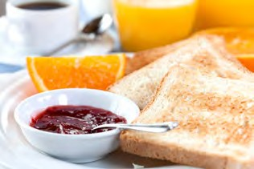


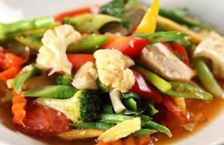
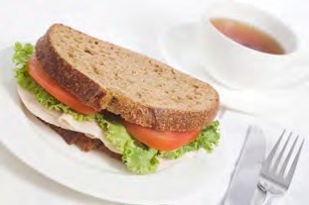
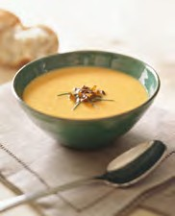

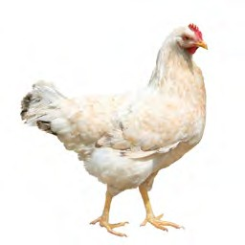
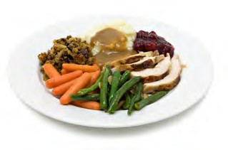
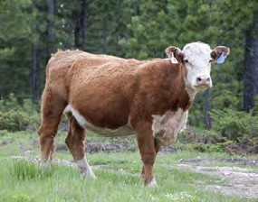
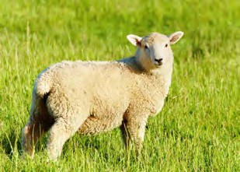

English Language Communication Cards
Kat bilong toktok long Tok Pisin Tokples
Breakfast
Breakfast
Breakfast
Kaikai long moning
Kaikai long moning
Kaikai long moning
Lunch
Lunch
Dinner
Kaikai long belo
Kaikai long belo
Kaikai long nait
Dinner
Fish
Chicken
Kaikai long nait
Pis
Kakaruk
Beef
Lamb
Pork
Bulmakau Abus
Sipsip
Pik

Slide 3









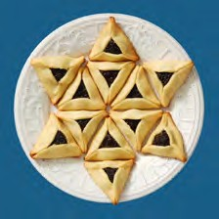


English Language Communication Cards
Kat bilong toktok long Tok Pisin Tokples
Water
Juice
Tea
Wara
Wara blong prut
Ti
Sugar
Milk
Coffee
Suga
Susu
Kopi
Beer
Wine
Bia
Wain
Vegetarian
Kosher
Halal
Kaikai blong gaden
Kosher
Halal

Slide 4








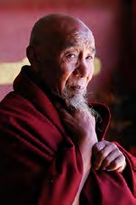
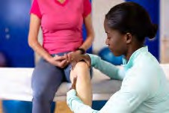

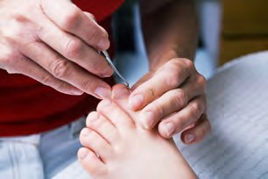
English Language Communication Cards
Kat bilong toktok long Tok Pisin Tokples
Interpreter
Family
Priest
Manmeri belong tanim tok
Femili
Pater
Rabbi
Imam
Priest
Rabbi
Imam
Pater
Nurse
Doctor
Monk
Nes
Dokta
Man blong lotu
Physiotherapist
Massage
Podiatrist
Fisioterapi
Presim o rabim skin
Lukautim lek

Slide 5

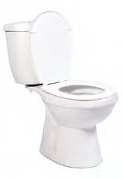



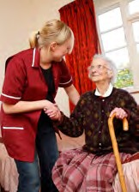
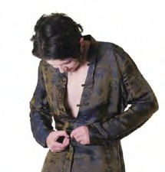
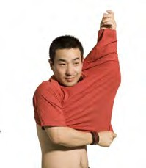


English Language Communication Cards
Kat bilong toktok long Tok Pisin Tokples
Shower
Toilet
Wash Hands
Waswas
Haus pekpek
Wasim han
Clean Teeth
Clean Room
Get Up
Wasim tit
Klin rum
Kirap
Get Dressed
Get Dressed
Putim kolos
Putim kolos
Get Undressed
Get Undressed
Rausim kolos
Rausim kolos

Slide 6



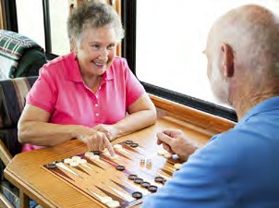
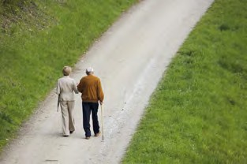

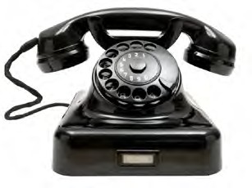
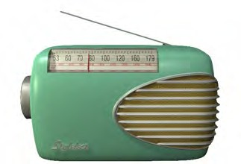



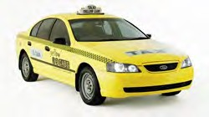
English Language Communication Cards
Kat bilong toktok long Tok Pisin Tokples
Rest
Sleep
Exercise
Malolo
Silip
Eksesais
Ativities
Go for a Walk
Go to the Garden
Ol wok
Go lon wokabaut
Go lon gaden
Telephone
Radio
Music
Telefone
Redio
Musik
Film
TV
Taxi
Piksa
TV
Taksi

Slide 7







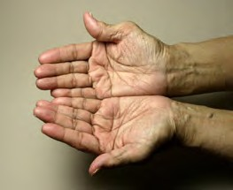

English Language Communication Cards
Kat bilong toktok long Tok Pisin Tokples
Light On
Light Off
What Time?
Lait i on
Lait i off
Wanem taim
Hot
Cold
Hat
Kol
Like
Dislike
Laik
Ino laik
Want
Don’t Want
Igat laik
Ino laik

Slide 8


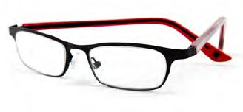



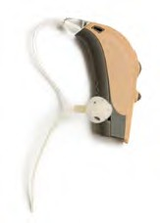
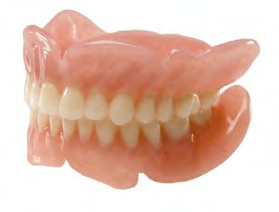
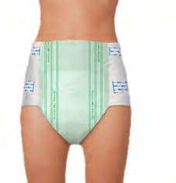


English Language Communication Cards
Kat bilong toktok long Tok Pisin Tokples
Book
Glasses
Comb
Buk
Glas
Kom
Watch
Jewellery
Makeup
Hanwas
Ol bilas
Bilas
Hearing Aid
Dentures
Incontinence Pad
Samting bilong harim tok
Giaman tit
Olsem napi
Tissues
Pillow
Tisu
Pilo

Slide 9




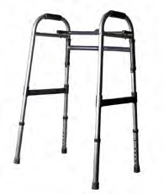
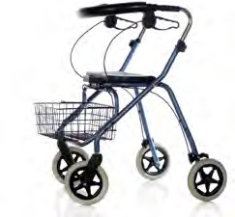
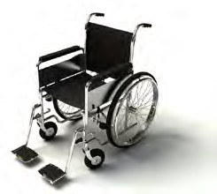

English Language Communication Cards
Kat bilong toktok long Tok Pisin Tokples
Pain
Pain Killer
Medication
Pen
Pen Marasin
Marasin
Walking Stick
Walking Frame
Wheeled Walker
Stik blong wokabaut
Bun blong wokabaut
Wil blong wokabaut
Wheelchair
Umbrella
Wilsia
Ambrela

Slide 10

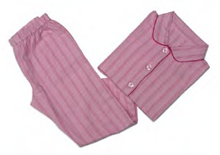
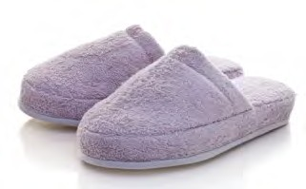
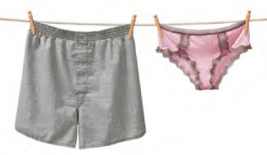
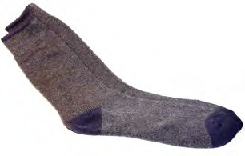

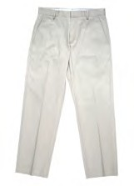


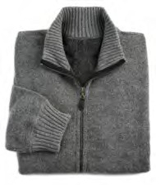
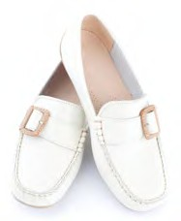

English Language Communication Cards
Kat bilong toktok long Tok Pisin Tokples
Dressing Gown
Sleepwear
Slippers
Kolos blong karamapim
Kolos blong silip
Slipas
Underwear
Socks
Shirt
Pans
Sokis
Siot
Trousers
Skirt
Dress
Trausis
Sket
Dres
Jumper
Shoes
Coat
Kolsiot
Su
Saket

