Slide 1

Communication Cards
Kat blong tok
English / Tok Pisin
Version 2024
4 antap
4 up
Dispela tok i olsem ol i bungim lon ples Centre lon olgeta kantri insait lon ol lapun lon yia 2024. Moni blong wokim dispela buk ikam long Ostrelia Gaviman blong helt na lukautim ol lapun.
Haus bung blong olgeta kantri long taim blong lapun isi isi long yia 2024.
This information was compiled by the Centre for Cultural Diversity in Ageing 2024.
This publication was funded by the Australian Government Department of Health and Aged Care.
©Centre for Cultural Diversity in Ageing 2024.

Slide 2

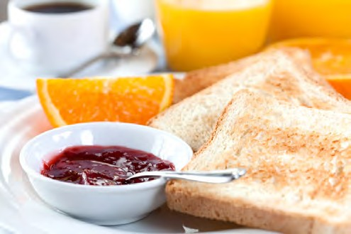


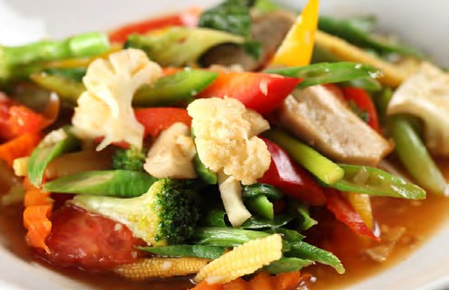
English Language Communication Cards
Kat bilong toktok long Tok Pisin Tokples
Breakfast
Kaikai long moning
Breakfast
Kaikai long moning
Breakfast
Kaikai long moning
Breakfast
Kaikai long belo

Slide 3

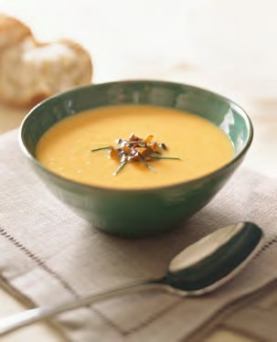
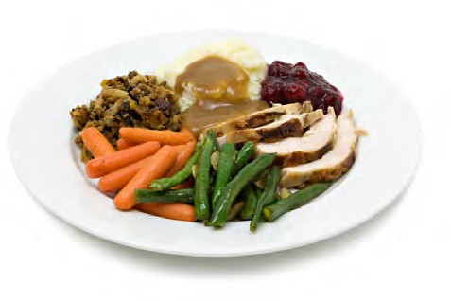
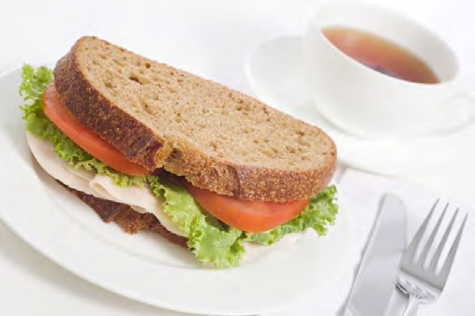

English Language Communication Cards
Kat bilong toktok long Tok Pisin Tokples
Lunch
Kaikai long belo
Dinner
Kaikai long nait
Dinner
Kaikai long nait
Fish
Pis
Pis

Slide 4
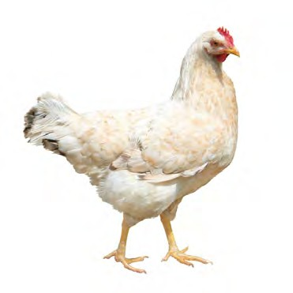
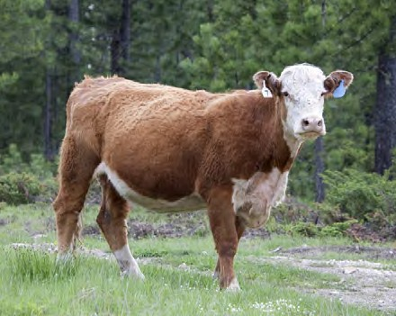
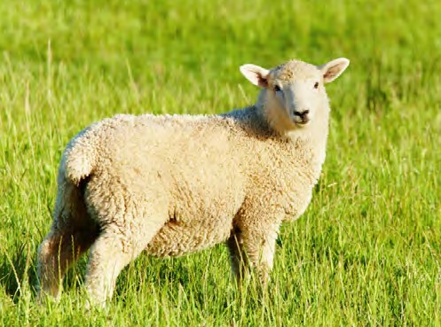

English Language Communication Cards
Kat bilong toktok long Tok Pisin Tokples
Chicken
Kakaruk
Beef
Bulmakau Abus
Lamb
Sipsip
Pork
Pik

Slide 5




English Language Communication Cards
Kat bilong toktok long Tok Pisin Tokples
Water
Wara
Juice
Wara blong prut
Tea
Ti
Sugar
Suga

Slide 6




English Language Communication Cards
Kat bilong toktok long Tok Pisin Tokples
Milk
Susu
Coffee
Kopi
Beer
Bia
Wine
Wain

Slide 7

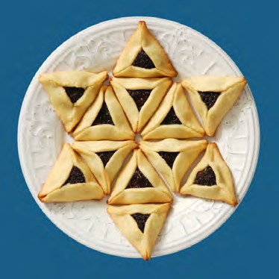

English Language Communication Cards
Kat bilong toktok long Tok Pisin Tokples
Vegetarian
Kaikai blong gaden
Kosher
Kosher
Halal
Halal

Slide 8

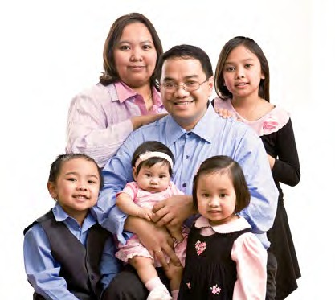

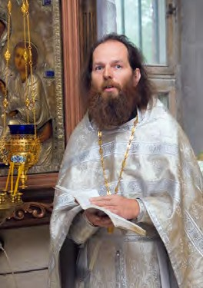
English Language Communication Cards
Kat bilong toktok long Tok Pisin Tokples
Interpreter
Manmeri belong tanim tok
Family
Femili
Priest
Pater
Priest
Pater

Slide 9


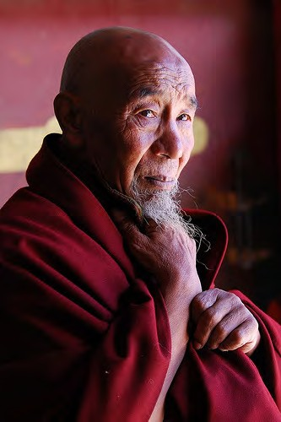

English Language Communication Cards
Kat bilong toktok long Tok Pisin Tokples
Rabbi
Rabbi
Imam
Imam
Monk
Man blong lotu
Doctor
Dokta

Slide 10

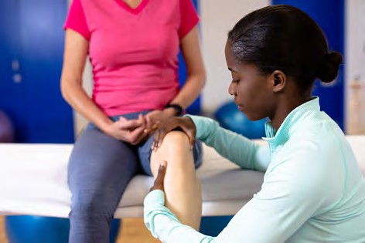
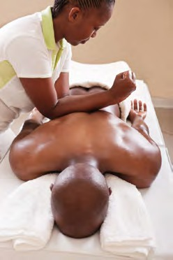
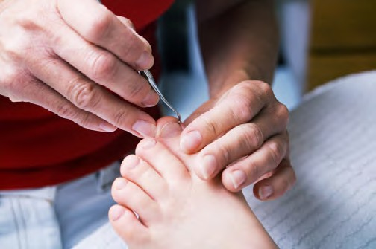
English Language Communication Cards
Kat bilong toktok long Tok Pisin Tokples
Nurse
Nes
Physiotherapist
Fisioterapi
Massage
Presim o rabim skin
Podiatrist
Lukautim lek

Slide 11
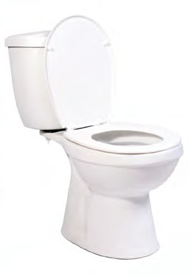


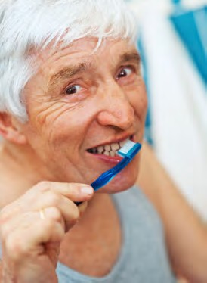
English Language Communication Cards
Kat bilong toktok long Tok Pisin Tokples
Shower
Waswas
Toilet
Haus pekpek
Wash Hands
Wasim han
Clean Teeth
Wasim tit

Slide 12
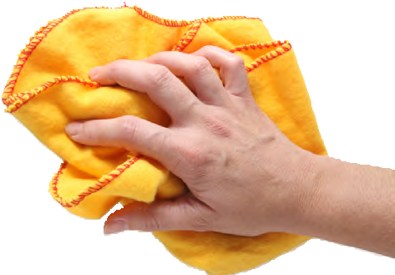
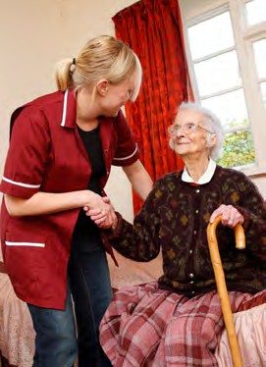
English Language Communication Cards
Kat bilong toktok long Tok Pisin Tokples
Clean Room
Klin rum
Get Up
Kirap

Slide 13
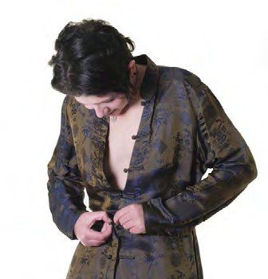



English Language Communication Cards
Kat bilong toktok long Tok Pisin Tokples
Get Dressed
Putim kolos
Get Dressed
Putim kolos
Get Undressed
Rausim kolos
Get Undressed
Rausim kolos

Slide 14


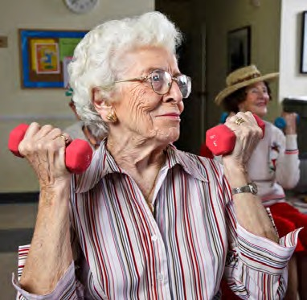
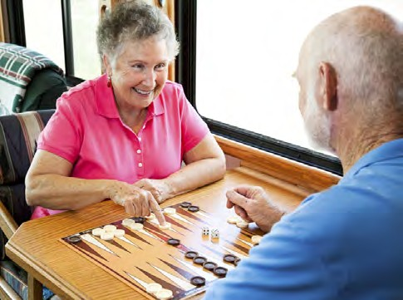
English Language Communication Cards
Kat bilong toktok long Tok Pisin Tokples
Rest
Malolo
Sleep
Silip
Excercise
Eksesais
Activites
Ol wok

Slide 15

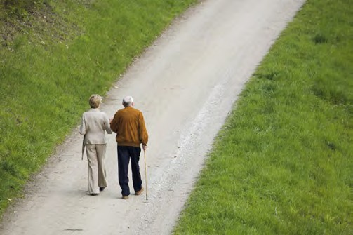
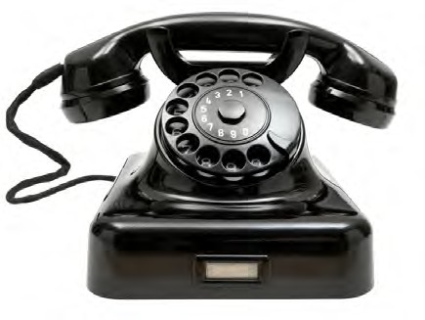
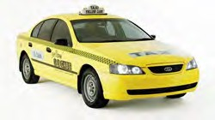
English Language Communication Cards
Kat bilong toktok long Tok Pisin Tokples
Go to the Garden
Go lon gaden
Go for a Walk
Go lon wokabaut
Telephone
Telefone
Taxi
Taksi

Slide 16
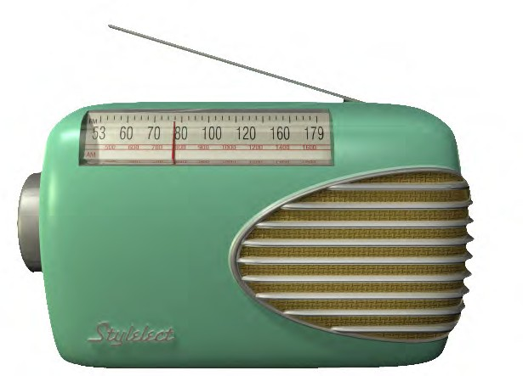


English Language Communication Cards
Kat bilong toktok long Tok Pisin Tokples
Radio
Redio
Music
Musik
Film
Piksa
TV
TV

Slide 17




English Language Communication Cards
Kat bilong toktok long Tok Pisin Tokples
Light On
Lait i on
Light Off
Lait i off
Hot
Hat
Cold
Kol

Slide 18


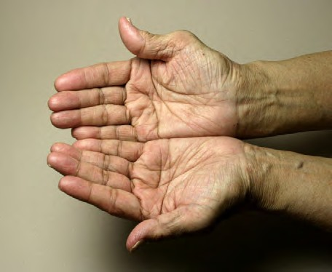

English Language Communication Cards
Kat bilong toktok long Tok Pisin Tokples
Like
Laik
Dislike
Ino laik
Want
Igat laik
Don’t Want
Ino laik

Slide 19

English Language Communication Cards
Kat bilong toktok long Tok Pisin Tokples
What time?
Wanem taim

Slide 20

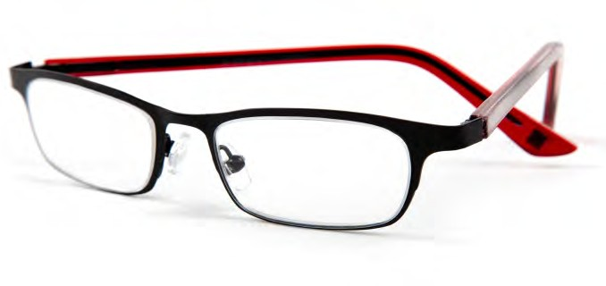


English Language Communication Cards
Kat bilong toktok long Tok Pisin Tokples
Book
Buk
Glasses
Glas
Comb
Kom
Makeup
Bilas

Slide 21
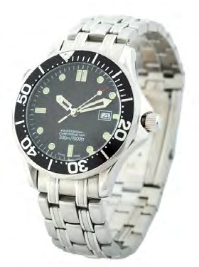

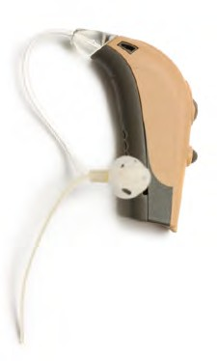
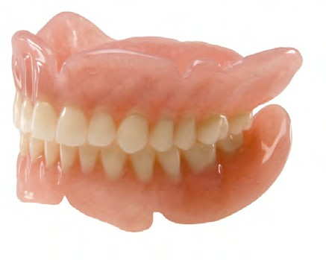
English Language Communication Cards
Kat bilong toktok long Tok Pisin Tokples
Watch
Hanwas
Jewellery
Ol bilas
Hearing Aid
Samting bilong harim tok
Dentures
Giaman tit

Slide 22

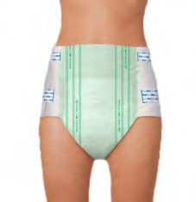

English Language Communication Cards
Kat bilong toktok long Tok Pisin Tokples
Tissues
Tisu
Incontinence Pad
Olsem napi
Pillow
Pilo

Slide 23
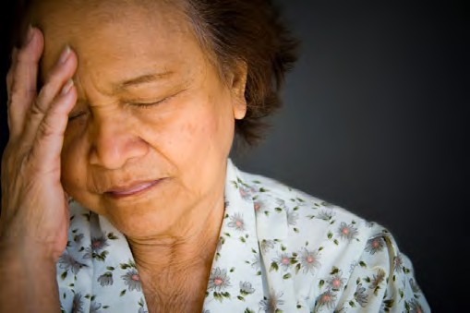



English Language Communication Cards
Kat bilong toktok long Tok Pisin Tokples
Pain
Pen
Painkiller
Pen Marasin
Medication
Marasin
Umbrella
Ambrela

Slide 24
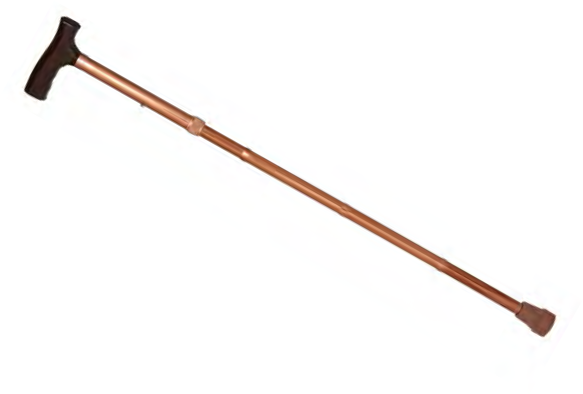
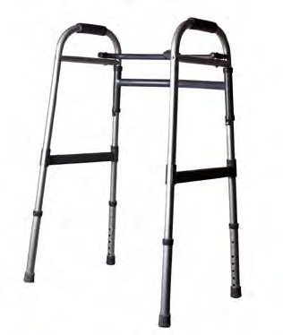
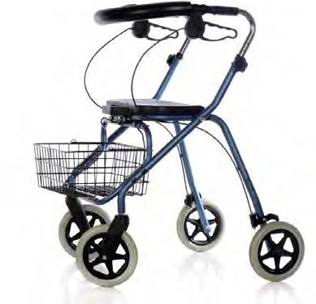
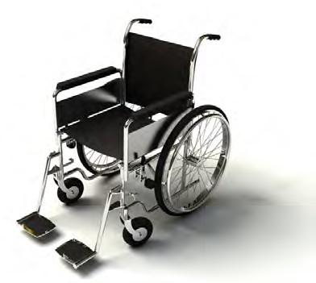
English Language Communication Cards
Kat bilong toktok long Tok Pisin Tokples
Walking Stick
Stik blong wokabaut
Walking Frame
Bun blong wokabaut
Wheeled Walker
Wil blong wokabaut
Wheelchair
Wilsia

Slide 25

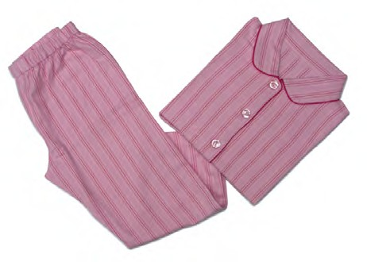
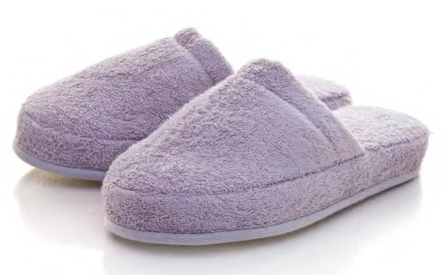
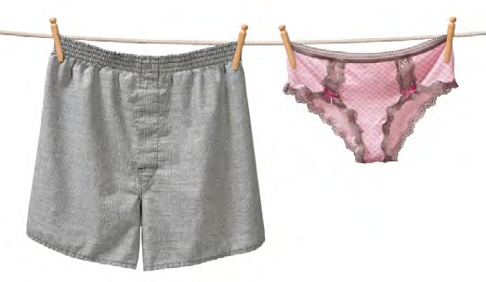
English Language Communication Cards
Kat bilong toktok long Tok Pisin Tokples
Dressing Gown
Kolos blong karamapim
Sleepwear
Kolos blong silip
Slippers
Slipas
Underwear
Pans

Slide 26
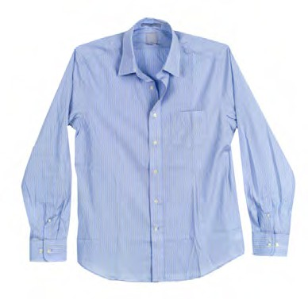
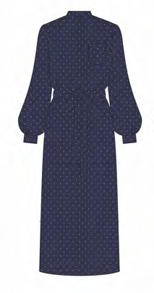
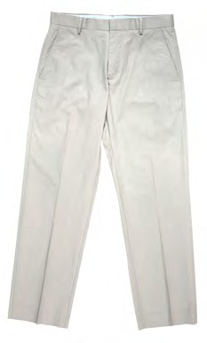

English Language Communication Cards
Kat bilong toktok long Tok Pisin Tokples
Shirt
Siot
Dress
Dres
Trousers
Trausis
Skirt
Sket

Slide 27
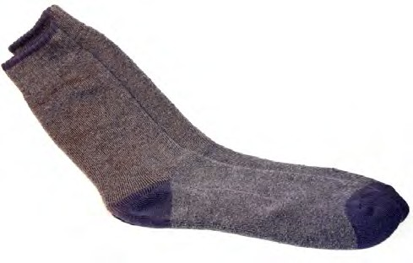
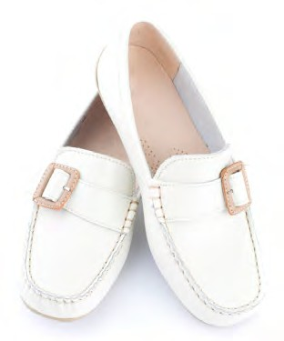
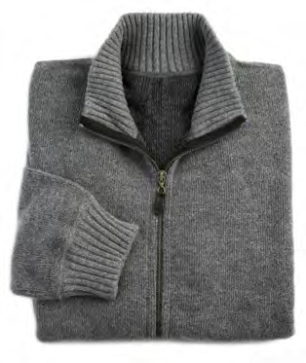
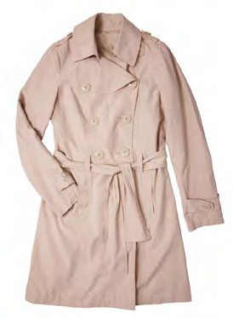
English Language Communication Cards
Kat bilong toktok long Tok Pisin Tokples
Socks
Sokis
Shoes
Su
Jumper
Kolsiot
Jacket
Saket

