Slide 1

About us
Chinese Community Social Services Centre Inc. (CCSSCI)was incorporated in October 1992.
It is the largest government-funded, non-profit welfare service provider for the Chinese-Australian Community in the State of Victoria.

Slide 2
Our Services
CCSSCI
Community Services
Home And Community Care Program (HACC)
Home Care Packages
On Luck Chinese Nursing Home

Slide 3
Community Services
Community Settlement Services
Community Partners Program
Mental Health Services
Social Connectedness Project
Joyful Line
Community Visitors Scheme
Care Buddies
Carer Supports Services - Chinese Parents Special Nets

Slide 4
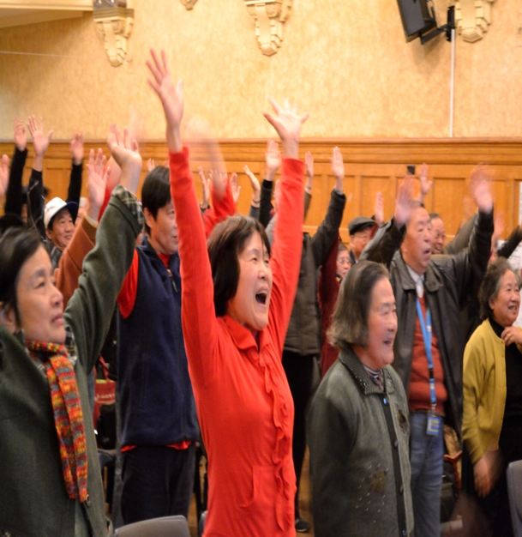
CHINESE SENIORS HAPPY AGEING DAY 2014

Slide 5
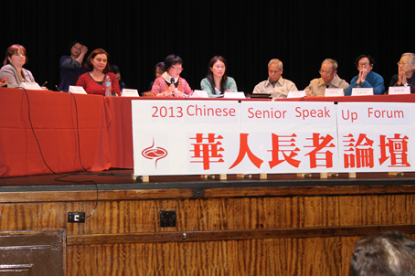
Background of the program
Based on the Chinese Senior Speak-up Forum held on the 22nd of November 2013, we compiled various views and comments regarding mental well-being issues of seniors and elder migrants in view of the various contributing barriers

Slide 6



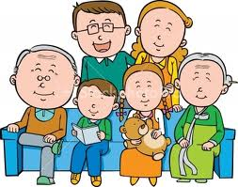
elder migrants in view of the various contributing barriers
facing with family relationship problem
financial issue
Mental Health
adjustment difficulties
Decline of physical health
lack of social support
Notes:
是否必須具備所有條件才能有豐盛晚年?
如果我身體不好、沒有收入，是否代表我希望了?

Slide 7
Background of the program
More support should be provided in services that promote a positive form of psycho-social well-being for elderly Chinese immigrants to access for the services in Australia.
CCSSCI therefore has decided to launch for the senior expo focusing on the mental well-being of Chinese elderly people.

Slide 8
What is CHINESE SENIORS HAPPY AGEING DAY 2014?
Aim
The Chinese Seniors Happy ageing day aims to enhance their information on how to age positively and various relaxation techniques.

Slide 9
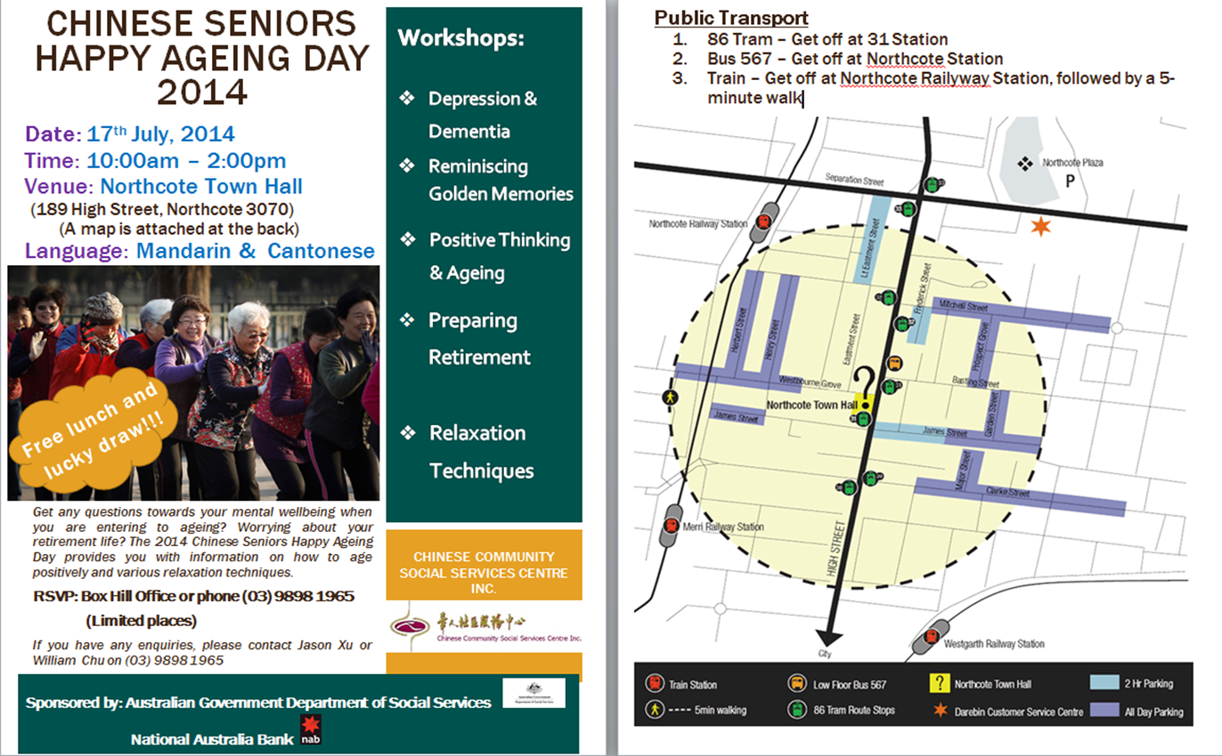

Slide 10
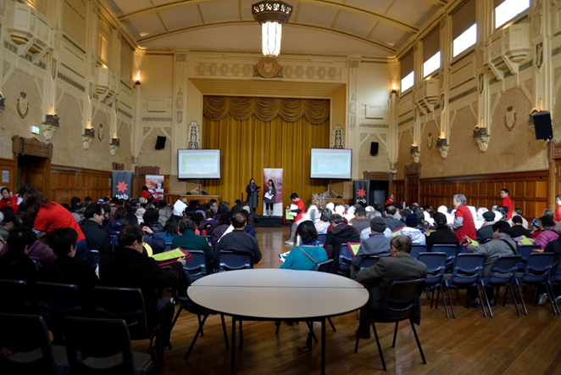
What is CHINESE SENIORS HAPPY AGEING DAY 2014?
New approach to deliver positive message about mental health
Using a conference style to provide the participants with choices to attend the topics they are interested.
We delivered a positive message regarding mental health. (To avoid stigma)

Slide 11
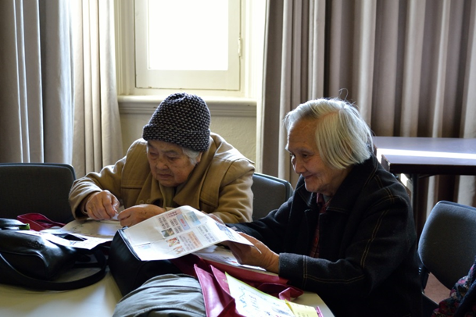
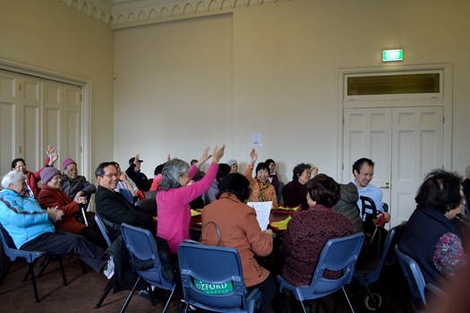
Over 10 workshop to cover a wide range of topics in the Happy Ageing Day:
Mental health literacy to talk about depression of older people

Slide 12
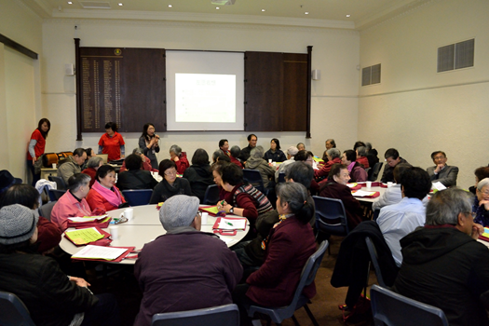
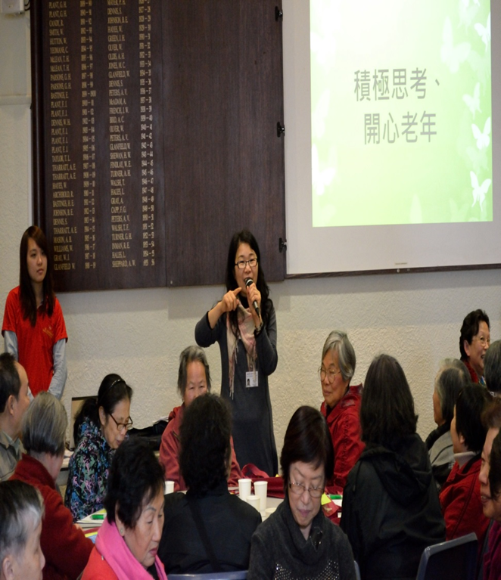
Over 10 workshop to cover a wide range of topics in the Happy Ageing Day:
Positive thinking toward ageing

Slide 13
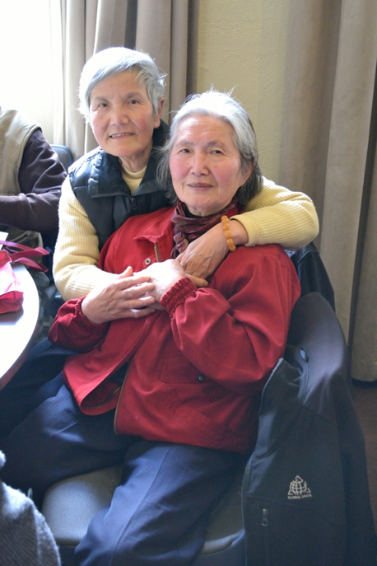
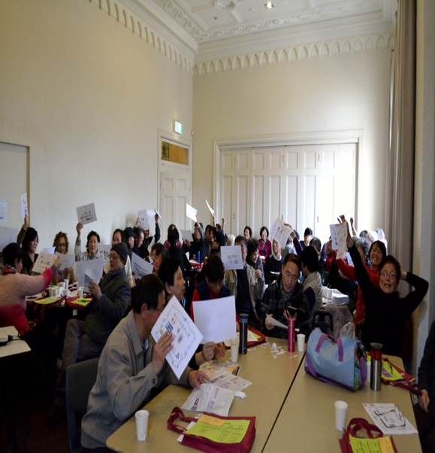
Over 10 workshop to cover a wide range of topics in the Happy Ageing Day:
How to have a better retirement life

Slide 14
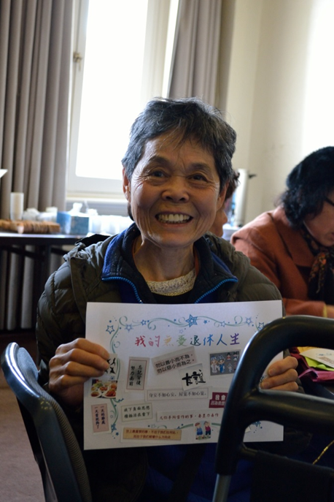
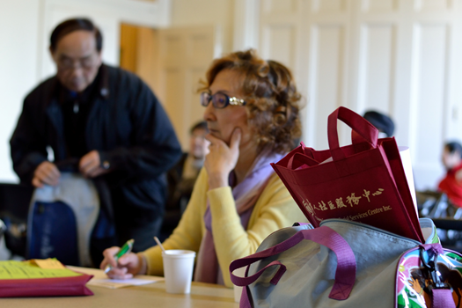
Over 10 workshop to cover a wide range of topics in the Happy Ageing Day:
Self-appraisal to affirm ones achievement and contribution in their life - (Video : IS TIME TO DECIDE)

Slide 15
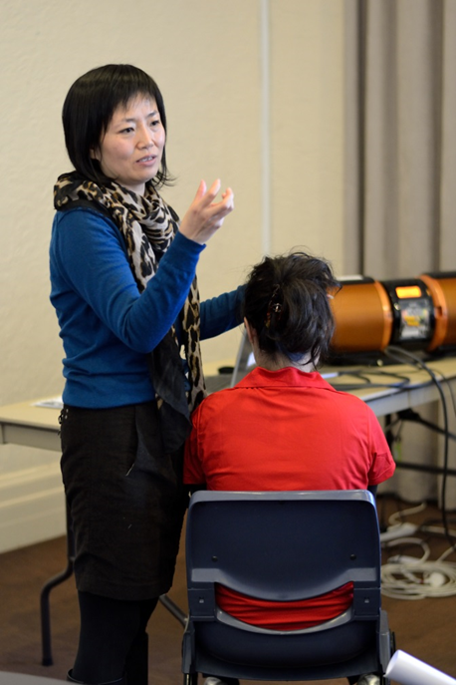
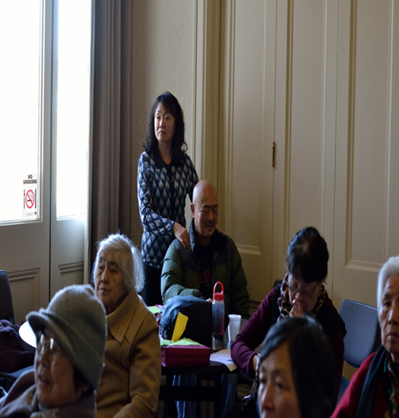
Over 10 workshop to cover a wide range of topics in the Happy Ageing Day:
Stress management skills: message therapy

Slide 16

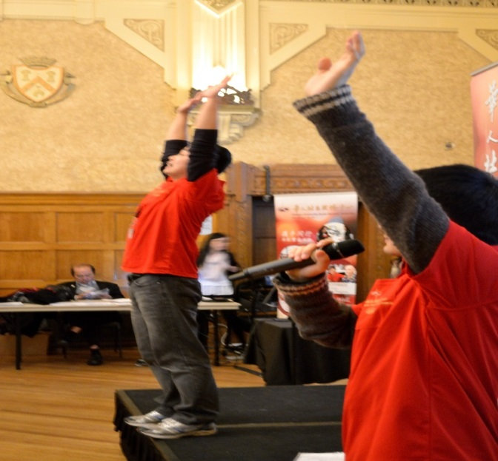
Over 10 workshop to cover a wide range of topics in the Happy Ageing Day:
Stress management skills:
laughing therapy

Slide 17
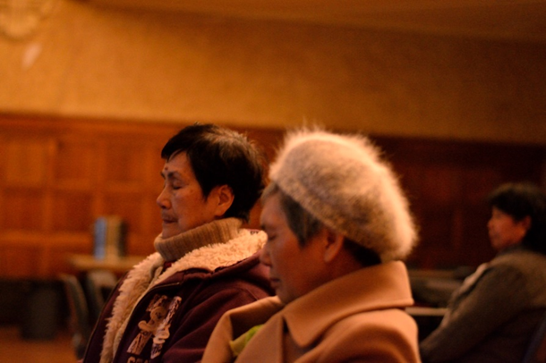
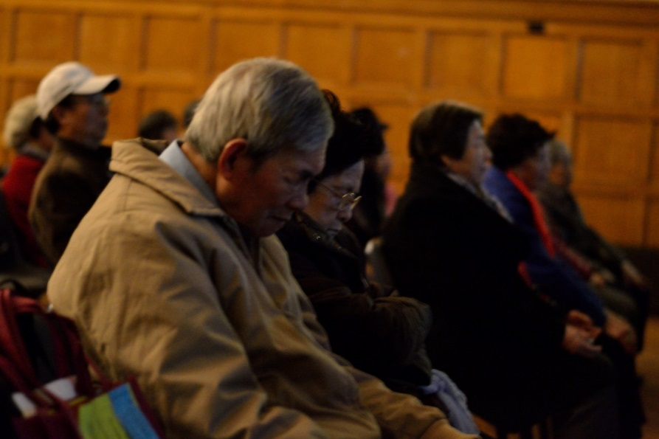
Over 10 workshop to cover a wide range of topics in the Happy Ageing Day:
Stress management skills:
relaxation exercise

Slide 18
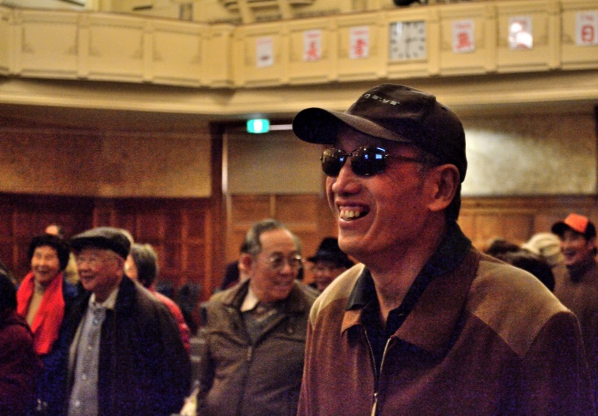
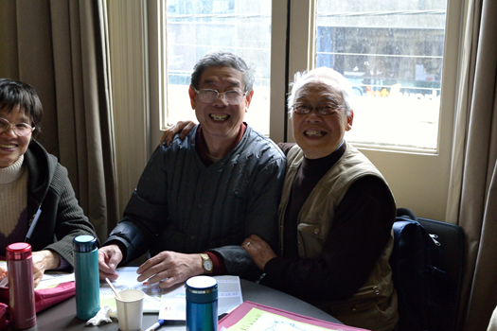
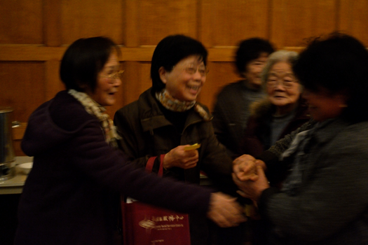
Result
Very positive feedback received from the participants

Slide 19
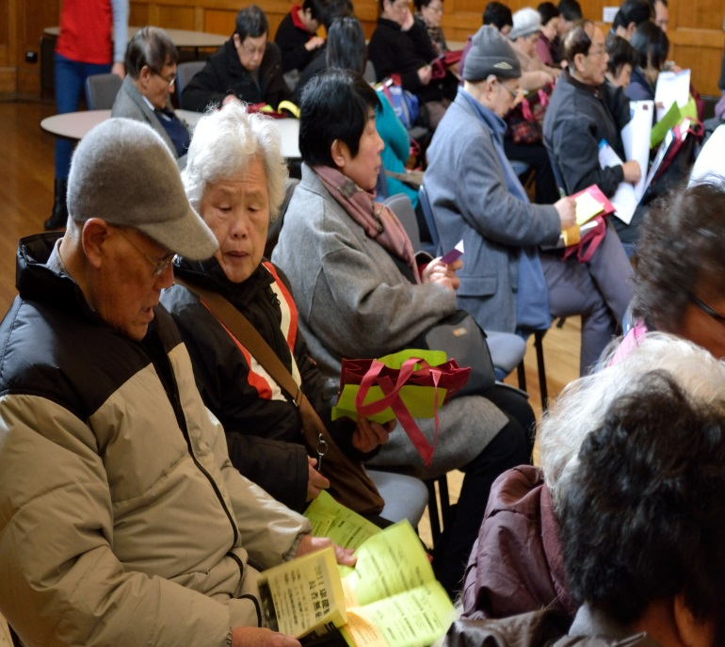
Result
Many people take few hours’ travel to the venues for they want to learn how to become happier in their older age.

Slide 20
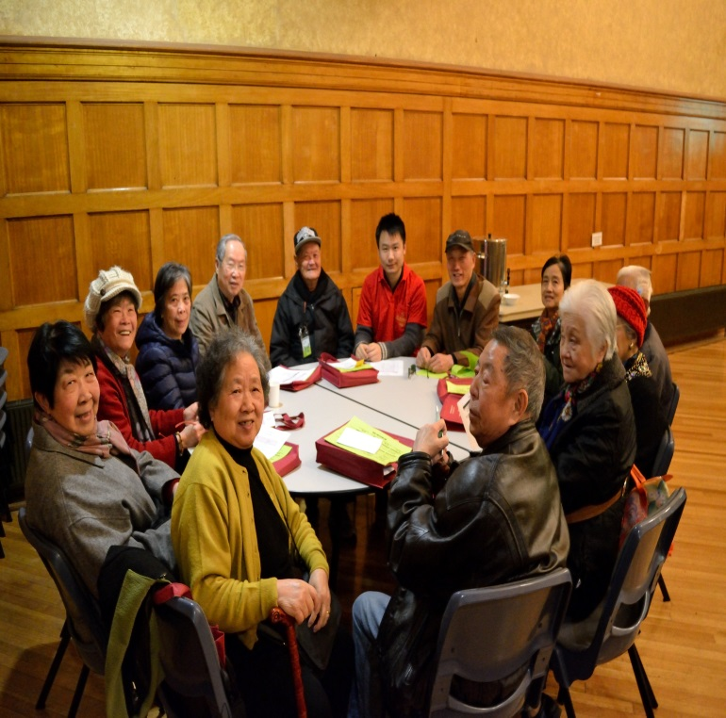
Result
The 180 participants were asked to fill out the evaluation form at the end of the workshop. The survey found that over 75% of participants are very satisfied and enjoy the program. Many participants suggested that the senior expo should be held once or twice a year

Slide 21
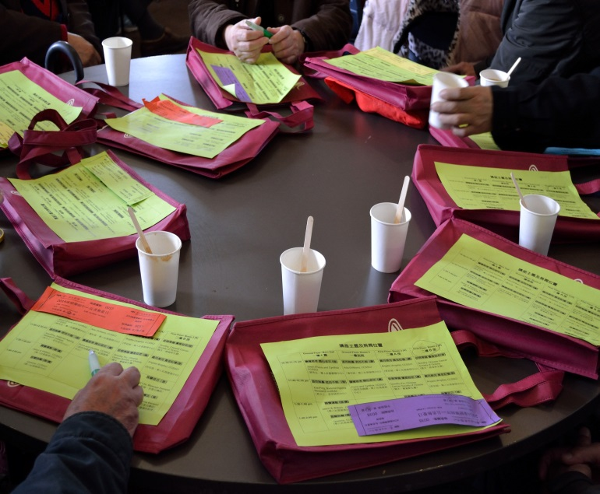
Suggestion:
to develop more culturally appropriate programs to deliver positive messages about ageing

Slide 22
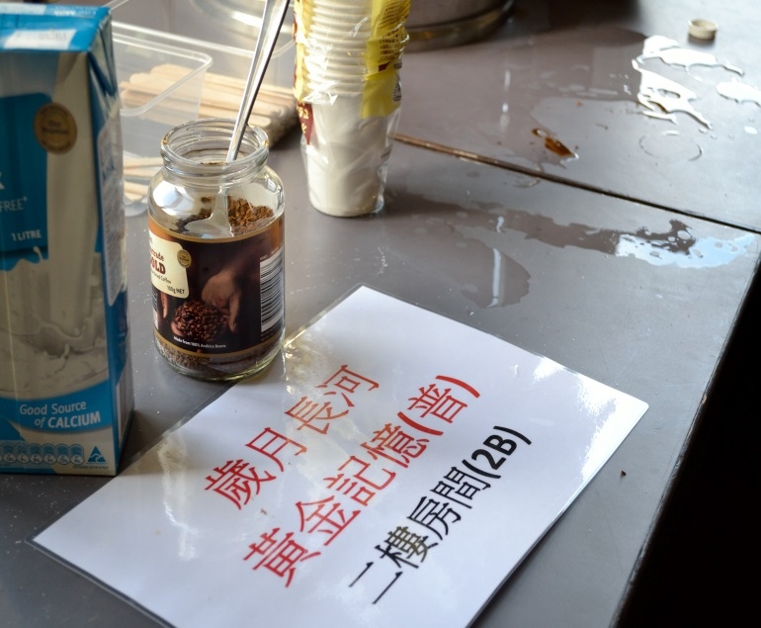
Suggestion:
using CBT (Cognitive Behaviour Therapy) to address their dysfunctional thoughts about ageing

Slide 23
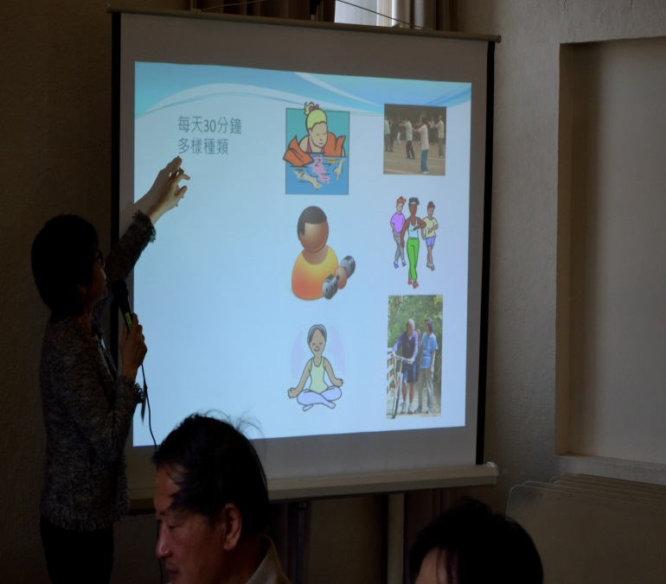
Suggestion:
to provide more meaningful social participation and volunteering for ageing to contribute to the community and obtain their satisfaction and achievement in turn.

Slide 24
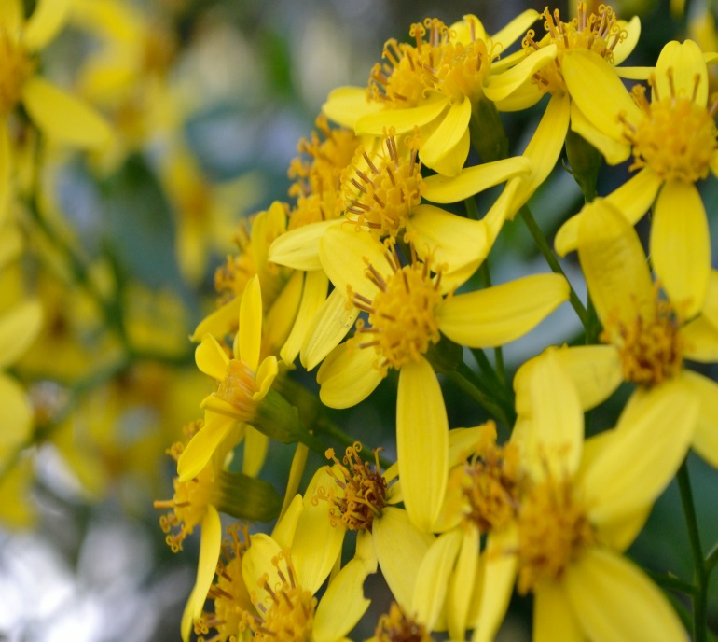
Suggestion:
increase their awareness of the symptoms of mental health issues

Slide 25
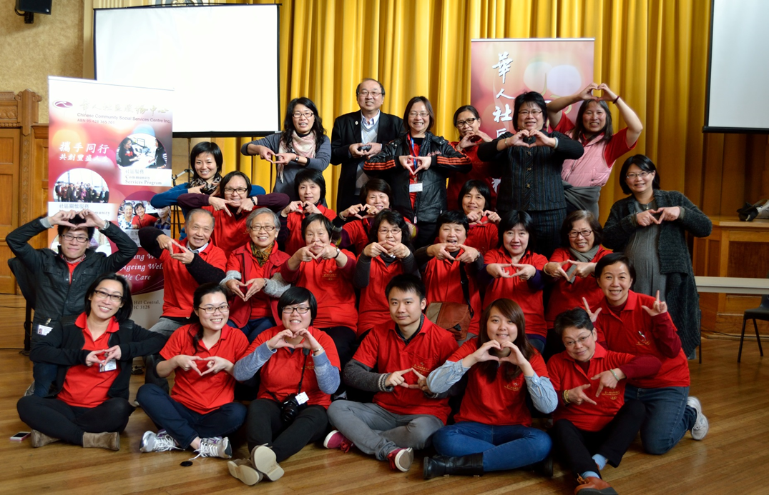
Thank you very much

